Slide 1



What can digital technologies add to screening and brief intervention for alcohol use in healthcare settings?
Presentation to NDARC, Sydney
Thursday 20th March 2014
Paul Wallace
Primary Care Director, NIHR Clinical Research Networks
Professor Primary Health Care (emeritus)
General Practitioner (retired)

Slide 2





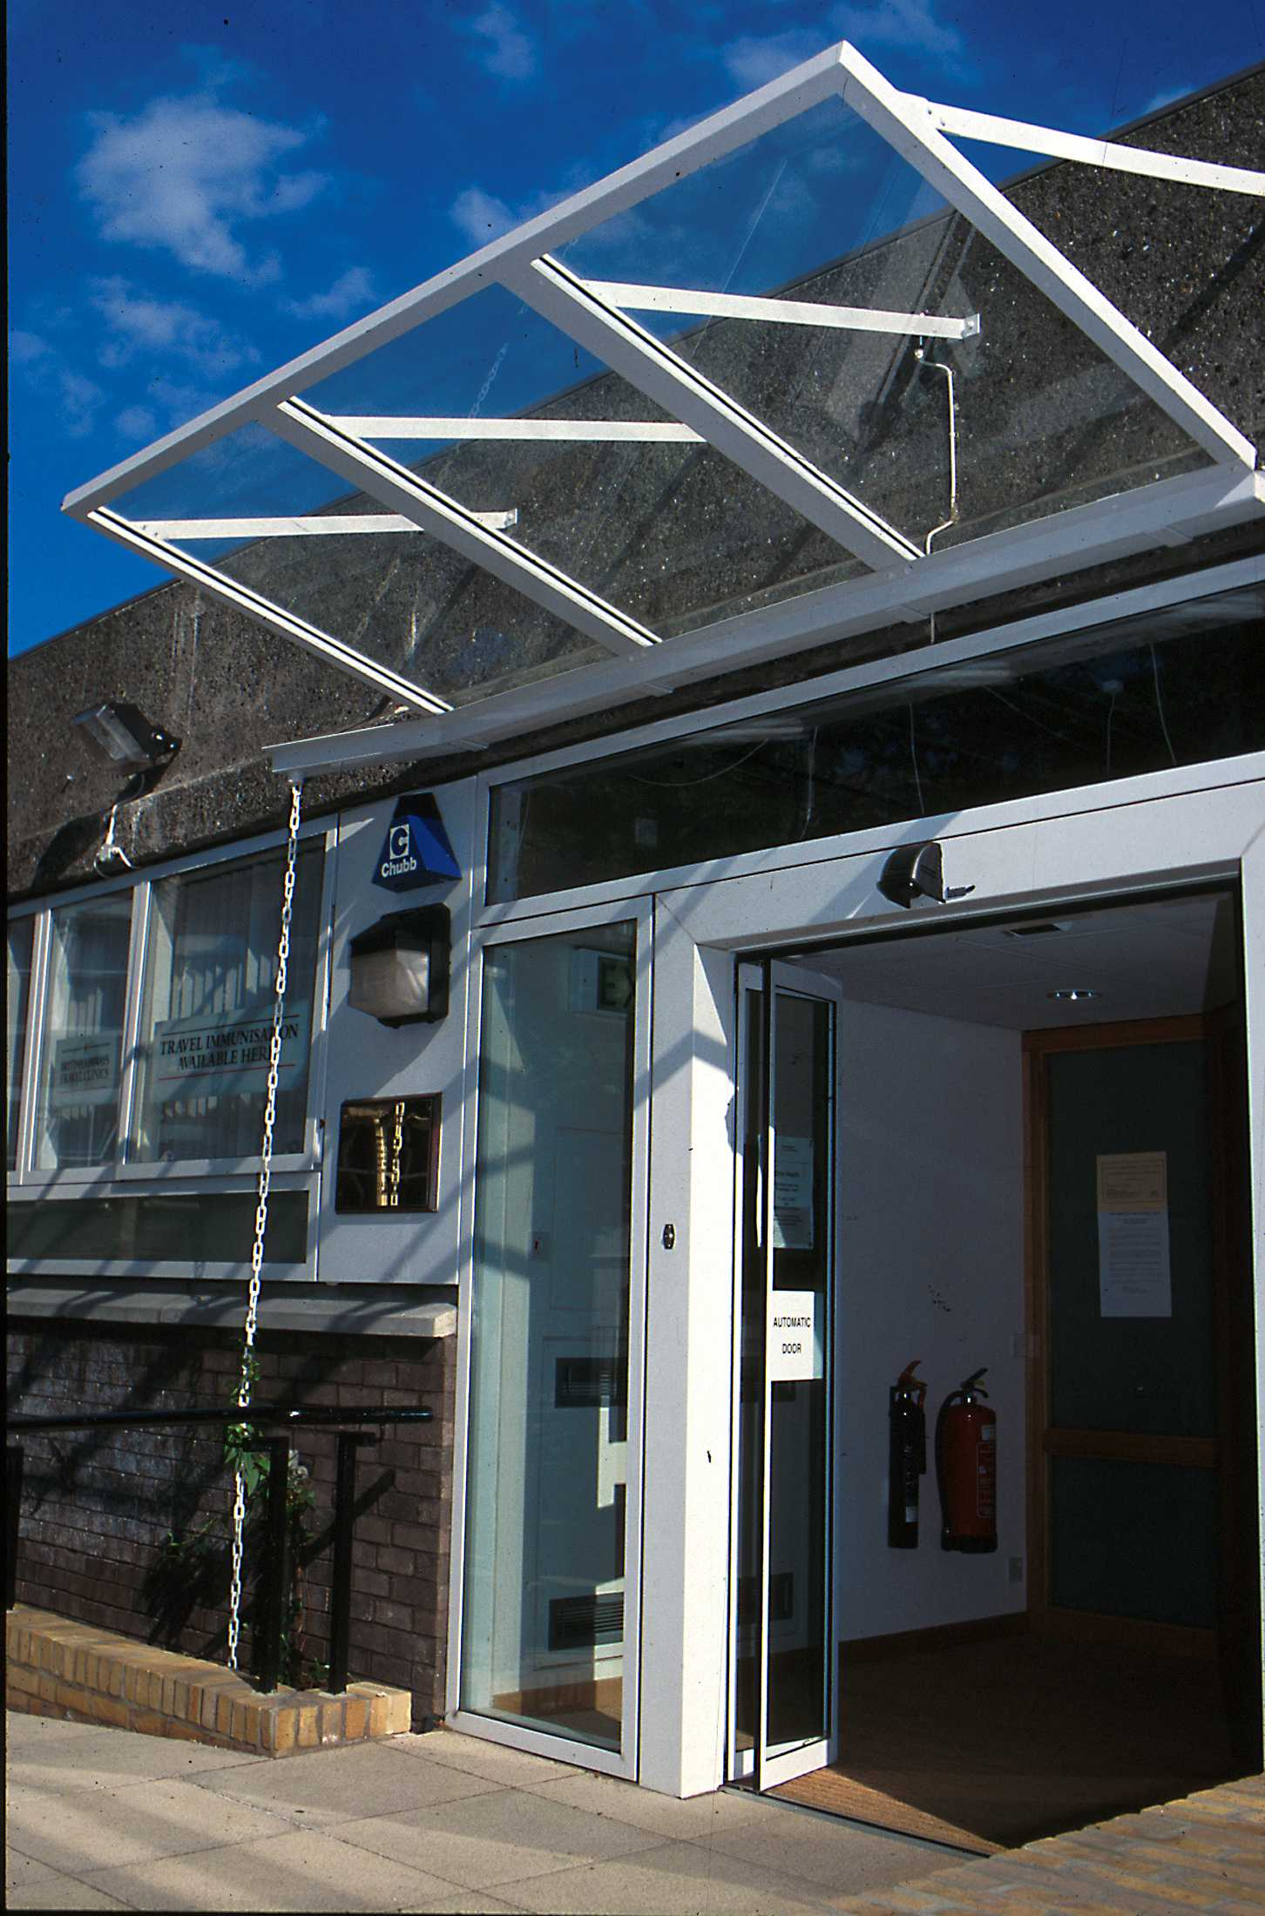
Professor of Primary Care
(emeritus)
GP Principal and Partner
(retired)
Director, NIHR Primary Care
Research Network

Slide 3
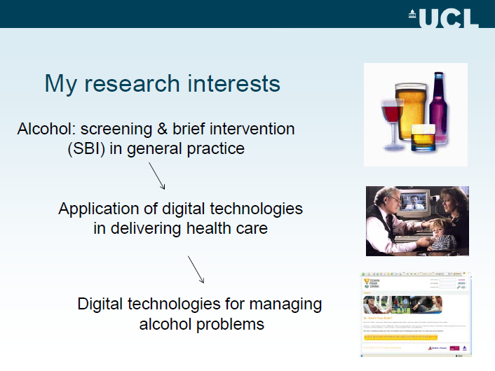

Slide 4
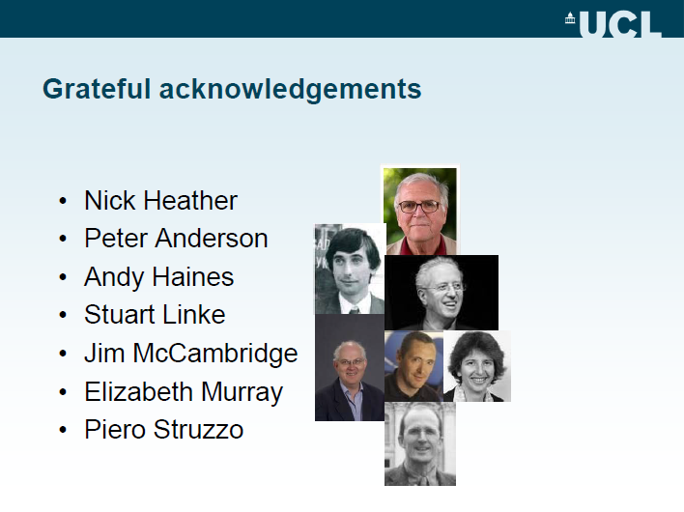

Slide 5

Scope of the presentation
Digital technologies and e-Health
Interventions for mental health and behavioural change using the Internet and mobile phones
Digital technologies for the delivery of screening and brief interventions for alcohol in primary care - the ODHIN and EFAR trials
Future directions of travel

Slide 6

Digital technologies
“Through digital technologies we know far more about the people we share this small planet with than ever before. The opportunities to harness digital technologies to enable more sustainable lifestyles are everywhere: in our energy, transport and food systems, in our built environment, between machines and between individuals.”
Niall Dunne, Chief sustainability officer BT 2011

Slide 7


Digital technologies and eHealth
Digital technologies fundamentally rely on the storage, transmission and processing of information in the form of binary code. This is a form of numerical notation which uses only two characters: 0 and 1.
eHealth is the use of emerging information and communication technologies, especially the internet to improve and enable health and health care
Eng 2001

Slide 8
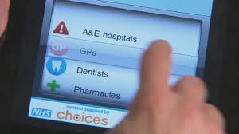
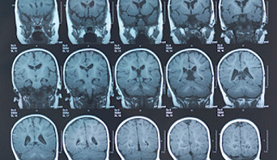
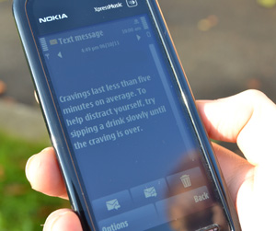
Applications of digital technologies in health care
Electronic care records (ECRs)
Digitalised investigations
  CT, MRI, PACS
Telemedicine and telecare
Research using ECRs and
databases
Internet and mobile technologies
for patients

Slide 9
Applications of digital technologies in health care
Electronic care records (ECRs)
Digitalised investigations
  CT, MRI, PACS
Telemedicine and telecare
Research using ECRs and
databases
Internet and mobile technologies
for patients

Slide 10


Electronic care records (ECRs)
Increasingly common in healthcare
Virtually universal in UK general practice
Increasing use of coded information
Inter-operability

Slide 11
Applications of digital technologies in health care
Electronic care records (ECRs)
Digitalised investigations
  CT, MRI, PACS
Telemedicine and telecare
Research using ECRs and
databases
Internet and mobile technologies
for patients

Slide 12
Applications of digital technologies in health care
Electronic care records (ECRs)
Digitalised investigations
  CT, MRI, PACS
Telemedicine and telecare
Research using ECRs and
databases
Internet and mobile technologies
for patients

Slide 13
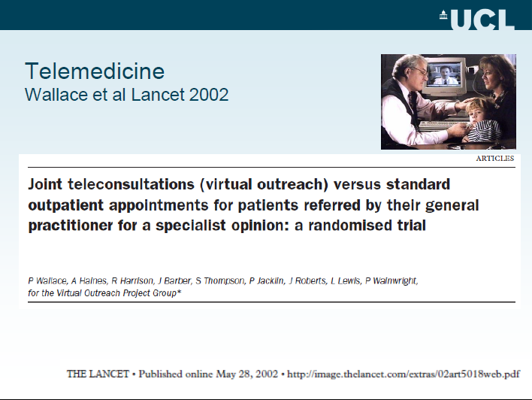

Slide 14
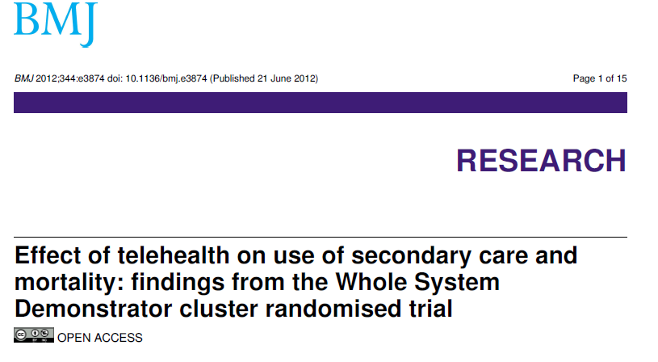
Telemedicine and telecare

Slide 15
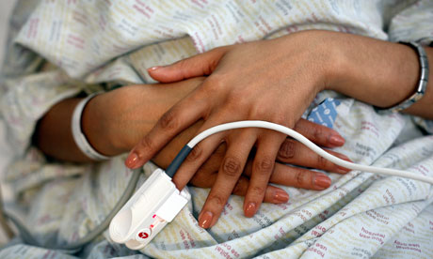
“More work needed on telehealth”
The Whole System Demonstrators showed that, "if used correctly", telehealth reduced death rates by 45%, NHS resource usage by 15-20% and tariff costs by 8%. With these striking results and the launch of the industry/NHS funded 3 Million Lives campaign, telehealth is steaming out of its backwater into the clinical mainstream.
Telehealth has benefits for patients with long-term conditions but despite industry excitement there are still areas of concern, argues Jeremy Wyatt
Guardian Professional,
Friday 6th Jan 2012

Slide 16
Applications of digital technologies in health care
Electronic care records (ECRs)
Digitalised investigations
  CT, MRI, PACS
Telemedicine and telecare
Research using ECRs and
databases
Internet and mobile technologies
for patients

Slide 17
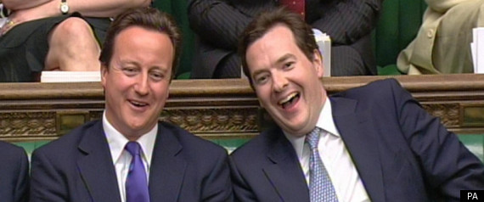
Research using ECRs and databases
“We’re going to consult on actually
changing the NHS constitution, so
that the default is for patients’ data to
be used for research – unless of course they want to opt out. The end result would be that every willing patient is a research patient…
…that every time you use the NHS you’re playing a part in the fight against disease, at home and around the world.”
David Cameron On Life Sciences 5.12.2011

Slide 18
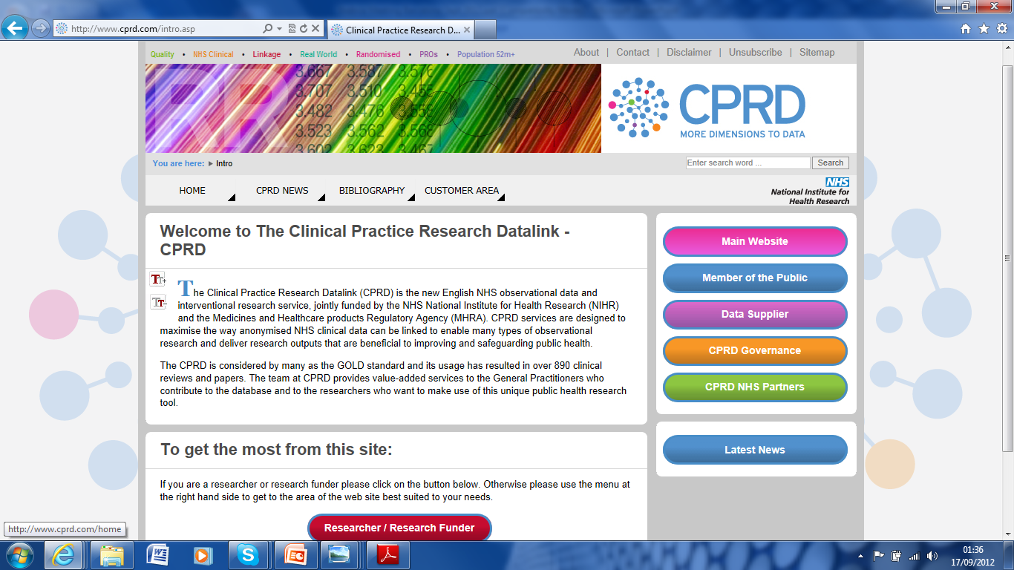
UK GP Records Database Research
GPRD
THIN
Q Research
Studies published on:
Arthritis, asthma, COPD, blood pressure, heart disease, Depression, anxiety schizophrenia, Diabetes, stroke, cancer, Parkinson’s Disease, liver and renal disease

Slide 19

14.02.2014
Subject: CPRD study reveals rising burden of gout in the UK
Dear Colleague,
The Clinical Practice Research Datalink (CPRD) remains at the forefront of epidemiology and other types of health research. This year already over 35 research projects have been enabled which represents a 75% increase since 2011. One recently published CPRD study has been on the burden of gout in the UK. Data showed that one in 40 people in the UK is affected, with highest prevalence in the North East and Wales.

Slide 20
Applications of digital technologies in health care
Electronic care records (ECRs)
Digitalised investigations
  CT, MRI, PACS
Telemedicine and telecare
Research using ECRs and
databases
Internet and mobile technologies
for patients

Slide 21
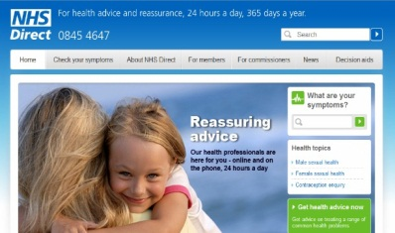
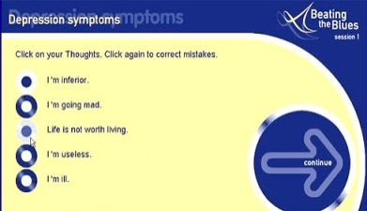
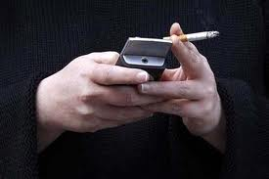
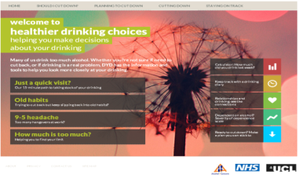
Internet & mobile technologies for patients
General health information
Mental health:
  anxiety
  depression
Behavioural change
  smoking cessation
  physical activity
  diet
  alcohol

Slide 22
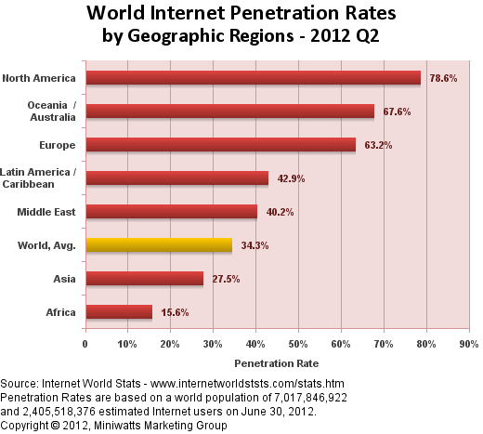
Access to the Internet

Slide 23
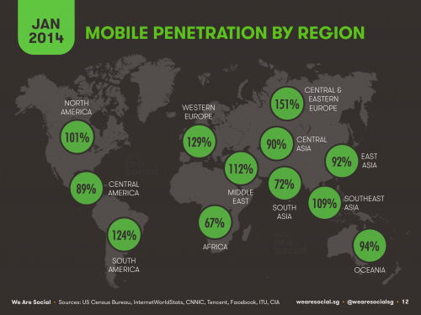
Mobile phone penetration
US Census Bureau and others 2014

Slide 24
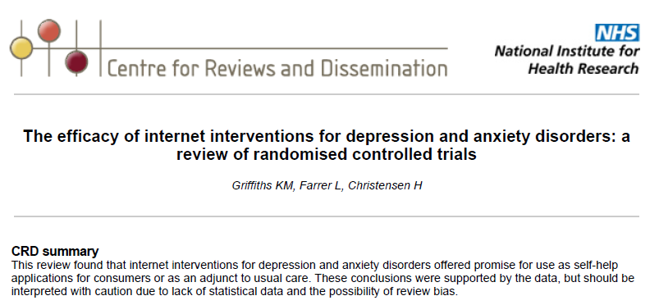

Digitally mediated interventions for mental health

Slide 25

Digitally mediated interventions for smoking cessation: Internet-based
Results suggest that some Internet-based interventions can assist smoking cessation especially if the information is appropriately tailored to the users and frequent automated contacts with the users are ensured, however trials did not show consistent effects

Slide 26


Digitally mediated interventions for smoking cessation: mobile phones
“The current evidence shows no effects of mobile phone-based smoking cessation interventions on long term outcome. While short term results are positive, more rigorous studies of long term effects of mobile phone-based smoking cessation interventions are needed”

Slide 27
The txt2stop study
Single-blind randomised trial involving more than 5,500 smokers across the UK, supported by the NIHR Primary Care Research Network.
Quit rate of txt2stop study participants was over double patients receiving the standard package – 10.7 per cent vs 4.9 per cent.
Over 5,000 people joined up
Txt2stop now widely implemented
.
Free et al, Lancet , July 2011

Slide 28

Behavioural change – meta-analysis of impact of design and mode of delivery
85 interventions reviewed
Impact of interventions highly variable
More extensive use of theory associated with larger effect sizes
Stress management and general communication skills training have greatest impact
Normative feedback best
*Webb et al JMIR 2010

Slide 29
Improved effectiveness is associated with:
More extensive use of theory (esp Theory of Planned Behaviour)
Inclusion of more behavioural techniques
Use of additional modes of interacting, esp text messages
*Webb et al JMIR 2010

Slide 30

Web-based interventions for alcohol consumption – a systematic review
“The current review is the first to systematically evaluate the effectiveness of such interventions and has found inconsistent results across studies. Process research suggests that web-based interventions are generally well received. However further randomized control trials are needed to investigate their effectiveness”.
Bewick et al, 2008 Preventive Medicine

Slide 31
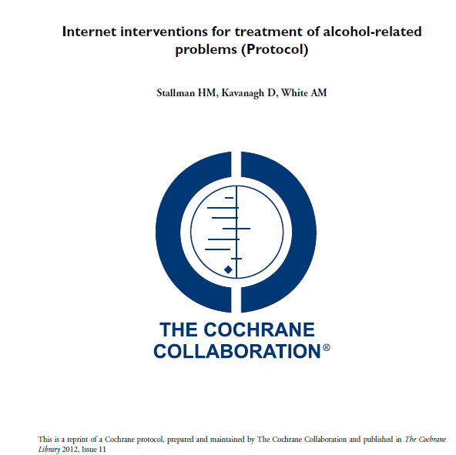
Cochrane review is currently underway
Helen Stallman, David Kavanagh, and Angela White
University of Queensland

Slide 32


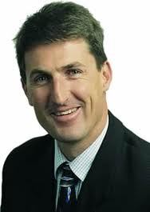

Recent studies on internet-based interventions for alcohol
  Heleen Riper
  John Cunningham
  Kyp Kypri

Slide 34
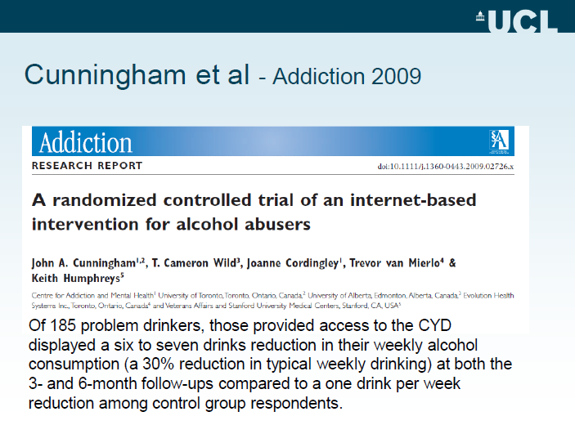

Slide 35
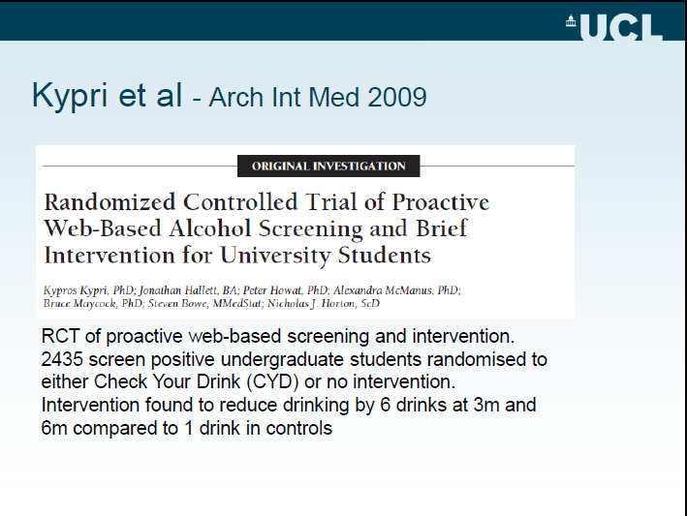

Slide 36
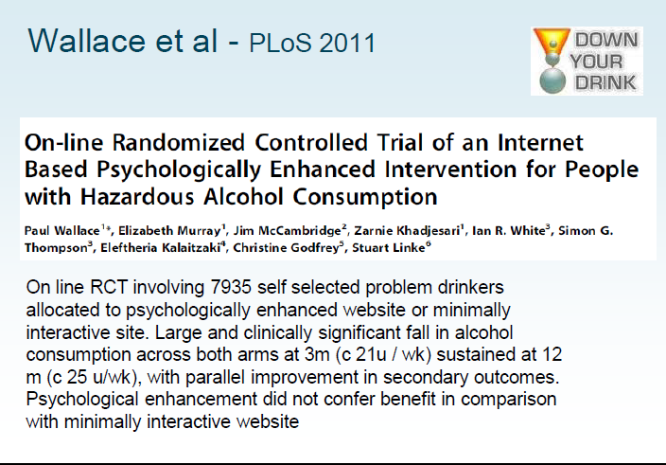

Slide 37
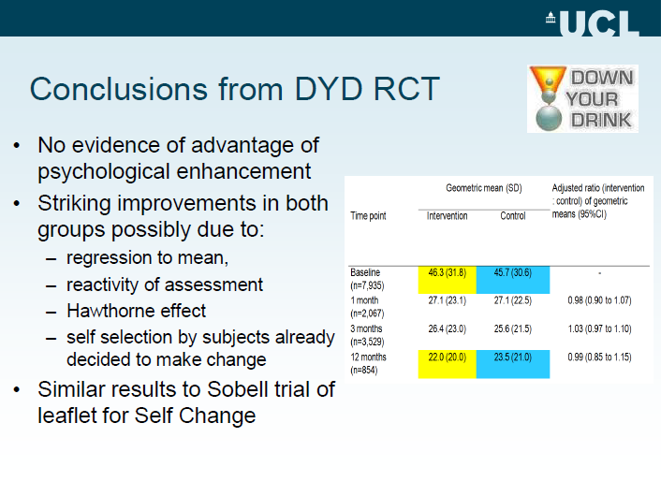

Slide 38
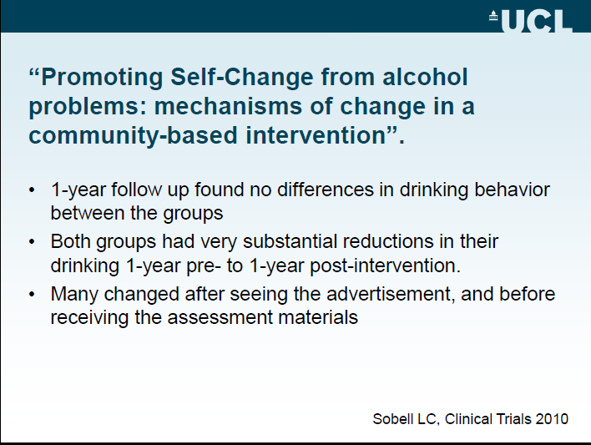

Slide 39
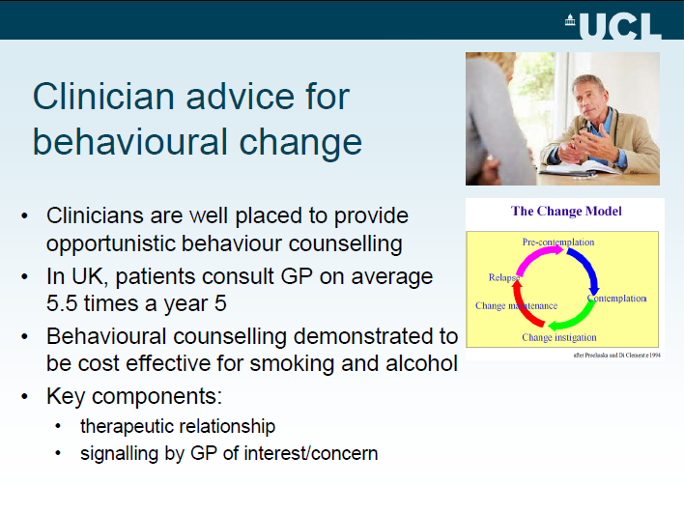

Slide 40
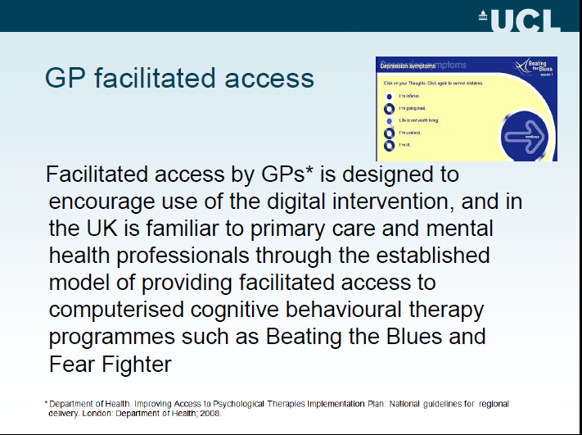

Slide 41
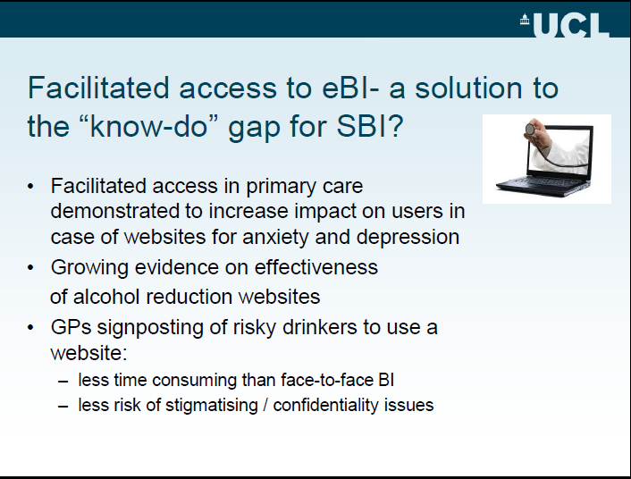

Slide 42


International trials currently underway to test GP facilitation of access to an alcohol reduction website
ODHIN trial:
Optimizing delivery
of health care interventions
EFAR trials: Italy and Spain
Non-inferiority randomised controlled
trial of facilitated access to an alcohol
reduction website

Slide 43


The ODHIN trial:
Peter Anderson et al
ODHIN: Optimizing delivery of health care interventions:
  Funded by Framework 7 EU
  5 European national partners
  Cluster RCT to evaluate impact on activity of:
    Education and training
    Financial incentives
    Digitally mediated brief intervention - eBI

Slide 44
ODHIN Work packages
WP 1 - Management and coordination
WP 2 - Systematic literature study
WP 3 - Cost effectiveness
WP 4 - Surveys
WP 5 - Stepped cluster RCT
WP 6 - Assessment tool
WP 7 - From science to policy

Slide 45
More specifically, this work package examines:
1. The effect of Continuous Medical Education (CME) to PHC providers
2. The effect of financial reimbursement to PHC providers as a pay-for-performance of brief alcohol interventions
3. Whether an alternative internet based method of delivering brief intervention can increase the proportion of patients reached
4. If one implementation strategy will give an added value to one already enforced.

Slide 46


Required features of ODHIN eBI
ODHIN specific website
Log in facility
Suitable brief screening tool with ability to calculate score and give feedback
Appropriate information on sensible drinking guidelines
Information on impact of alcohol on health and wellbeing
Drink diary facility

Slide 47
Desirable additional features of ODHIN eBI
Interactive tools relating to motivational interviewing, cognitive behavioural therapy
Reminder facilities for follow-up activity
Facility to produce printed feedback

Slide 48
ODHIN – the eBI patient leaflet
Why am I giving you this personalized referral leaflet?
I am giving you this personalized referral leaflet with your own Internet login number because I would like you to make use of the Internet based advice resources at
www.healthierdrinkingchoices.org.uk
This specially designed website which can only be used following a GP referral will help you reflect on your drinking and the possible impact it might be having on your health and wellbeing. It will also give you the chance to make some positive choices about how you are going to drink in the future.

Slide 49
ODHIN – the patient leaflet
This leaflet gives you details of how to log on using the personalized GP referral username and password which you’ll find in the box below. Either of these can be changed once you have logged on to create your own personal profile if you wish.
Either way, your data is completely confidential and no-one else will be able to see which information you enter on the website.
What to do now?
Please find a time over the next 2-3 days when you are able to use an appropriate way to access the Internet at home or elsewhere.
Once you are online, please access the HealthierDrinkingChoices website either by typing “healthydrinking choices” into your browser by going directly to www.healthierdrinkingchoices.org.uk
Once you have found the website, please log on using the personalized username and password below:
Your username: 01003
Your password: XXXXX

Slide 50
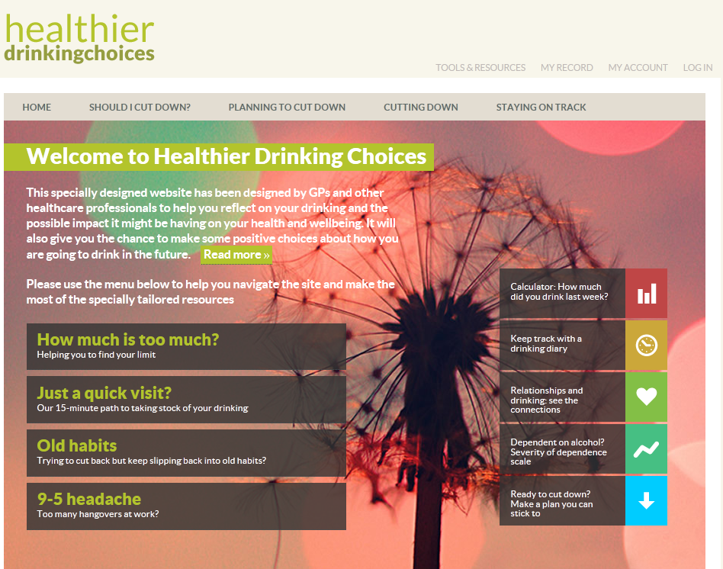
www.healthierdrinkingchoices.org.uk*
* Developed from www.downyourdrink.org.uk

Slide 51

www.healthierdrinkingchoices.org.uk

Slide 52
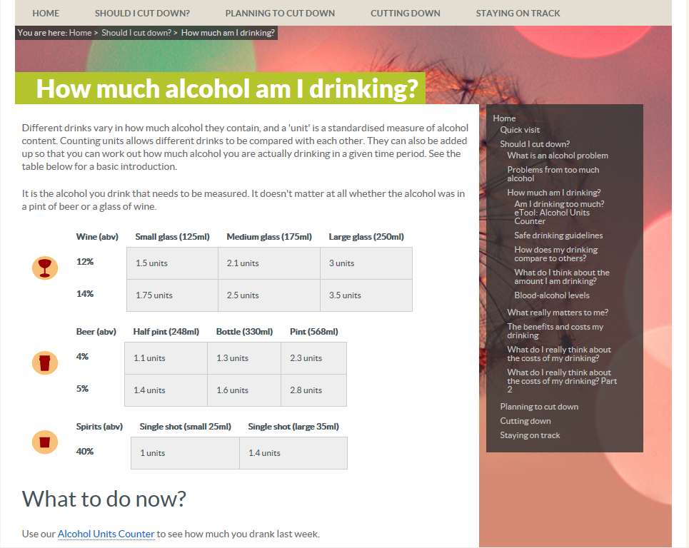
www.healthierdrinkingchoices.org.uk

Slide 53
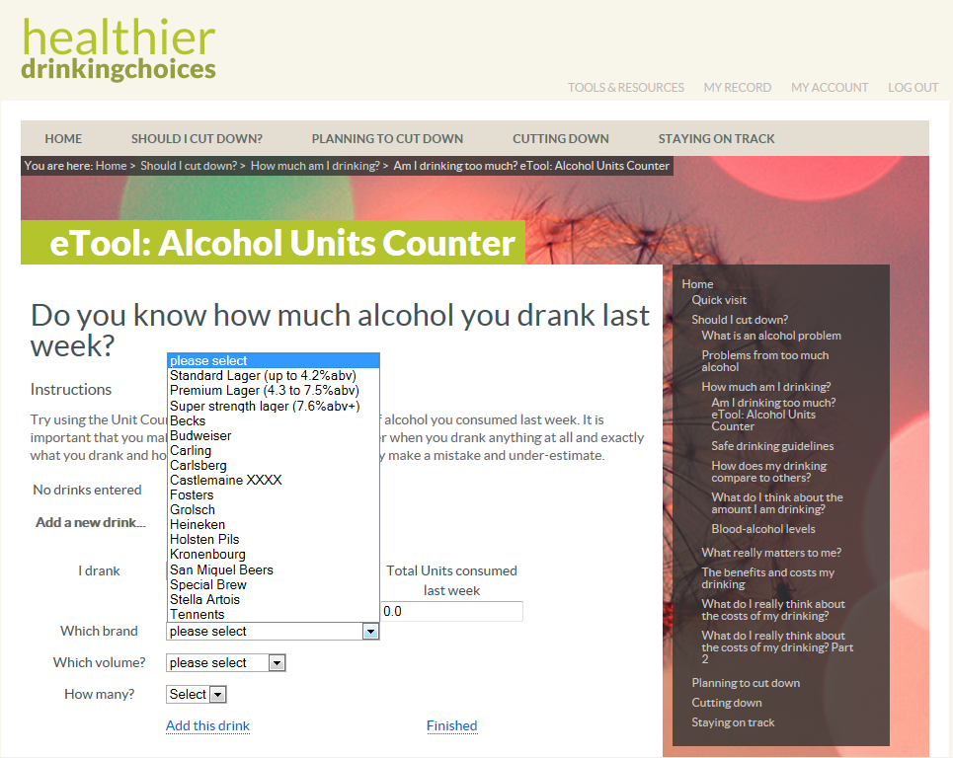
www.healthierdrinkingchoices.org.uk

Slide 54
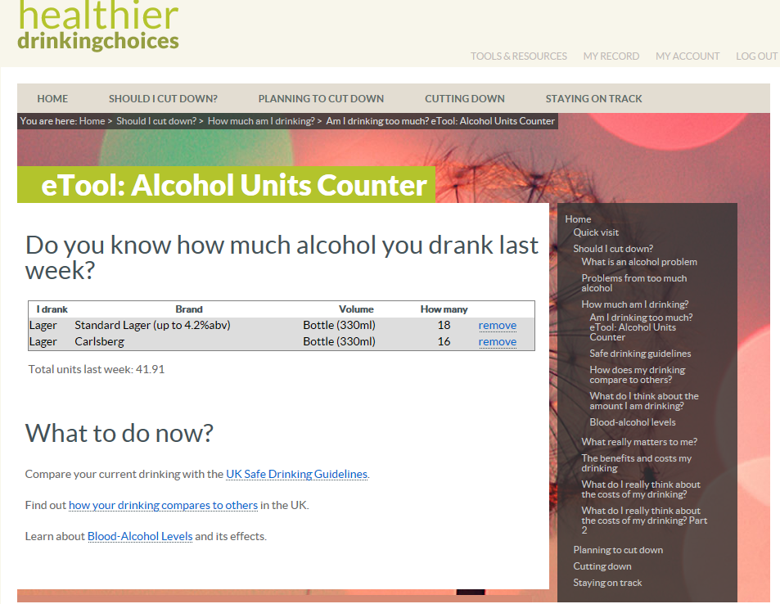
www.healthierdrinkingchoices.org.uk

Slide 55
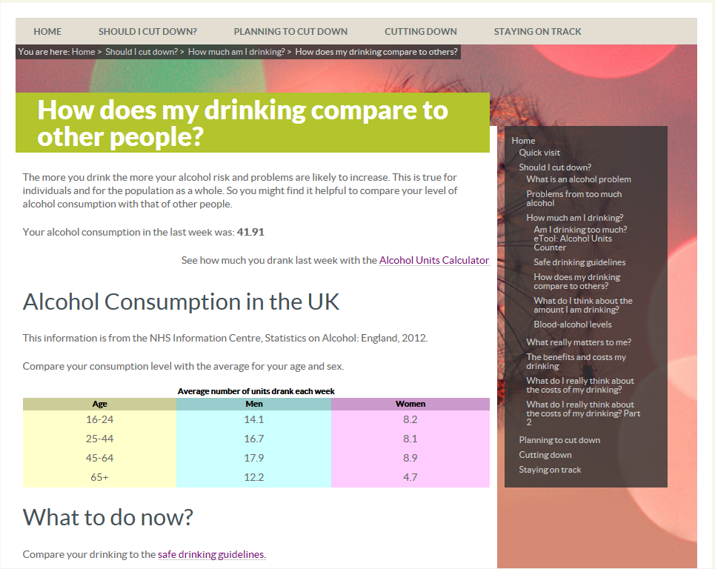
www.healthierdrinkingchoices.org.uk

Slide 56

www.healthierdrinkingchoices.org.uk

Slide 57
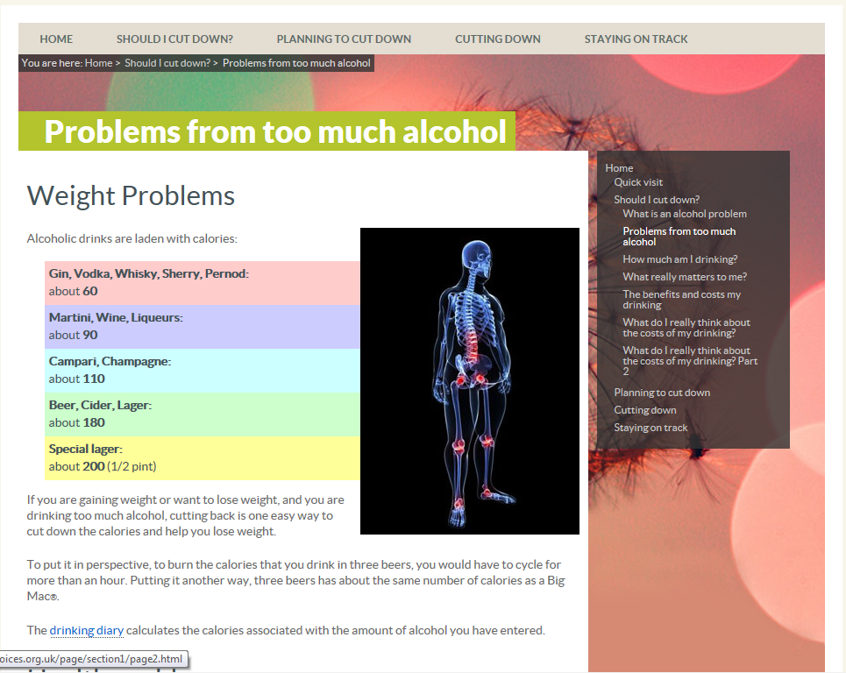
www.healthierdrinkingchoices.org.uk

Slide 58
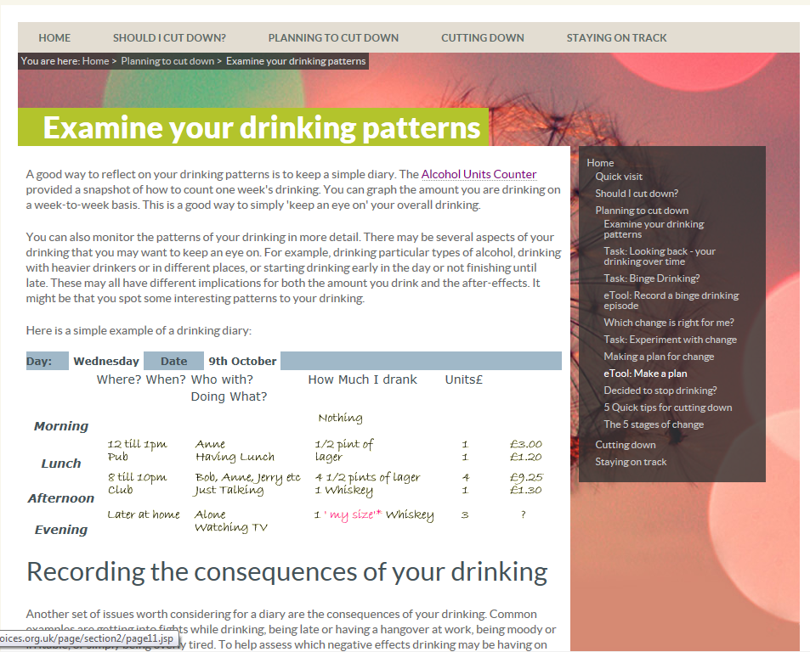
www.healthierdrinkingchoices.org.uk

Slide 59
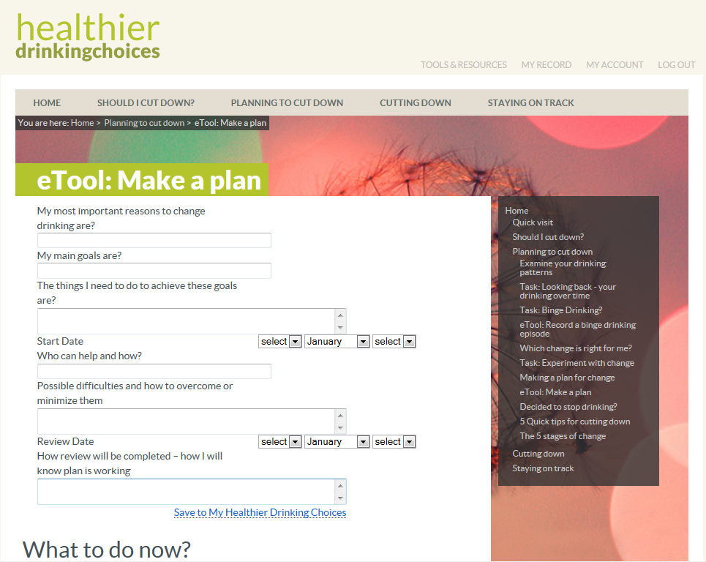
www.healthierdrinkingchoices.org.uk

Slide 60
ODHIN eBI : preliminary findings - Newcastle
Centre | Practitioner ID | Total patients screened positive | Total e-BI referrals in Implementation Period | Total patients logged on | Proportion of screen +ve patients referred to e-BI | Proportion of referred patients that logged on
Ncl | 201 | 13 | 3 | 1 | 0.231 | 0.333
Ncl | 202 | 24 | 8 | 3 | 0.333 | 0.375
Ncl | 203 | 3 | 0 | 0 | 0.000 | 0.000
Ncl | 204 | 17 | 7 | 4 | 0.412 | 0.571
Ncl | 401 | 8 | 3 | 1 | 0.375 | 0.333
Ncl | 402 | 33 | 16 | 1 | 0.485 | 0.063
Ncl | 403 | 14 | 7 | 2 | 0.500 | 0.286
Ncl | 408 | 7 | 0 | 0 | 0.000 | 0.000
Ncl | 501 | 11 | 0 | 0 | 0.000 | 0.000
Ncl | 502 | 77 | 7 | 2 | 0.091 | 0.286
Ncl | 503 | 19 | 3 | 1 | 0.158 | 0.333
Ncl | 901 | 11 | 7 | 4 | 0.636 | 0.571
Ncl | 902 | 10 | 0 | 0 | 0.000 | 0.000
Ncl | 903 | 12 | 0 | 0 | 0.000 | 0.000

Slide 61
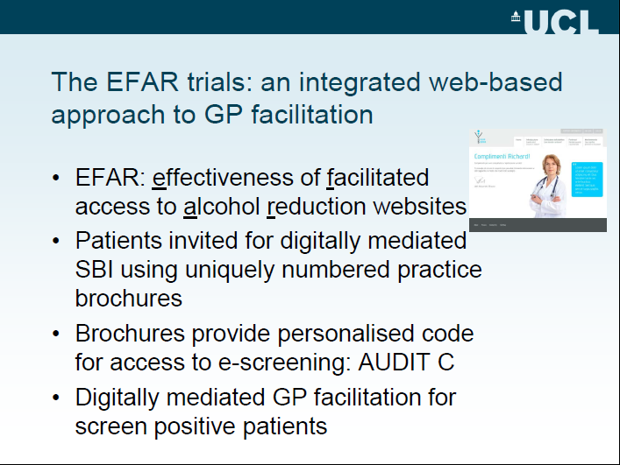

Slide 62

EFAR: effectiveness of facilitated access to alcohol reduction websites
  EFAR UKAIS
  RCT of eBI vs simple computer printout
  Conditionally funded by BUPA
  to be run in Italy, Spain, Australia, UK

Slide 63
Current status of EFAR trials
Italy : EFAR FVG – pilot completed and main trial commenced
Spain: EFAR-Spain – in planning stage. Inaugural meeting for GPs on 25th April
Australia: DYD-Australia submission to NHMRC to be further developed
UK – EFAR-UK in planning stage with Bridgette Bewick and Eileen Kaner

Slide 64
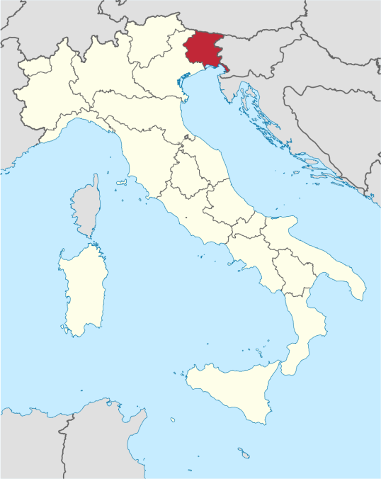






Italy - the EFAR FVG project

Slide 65
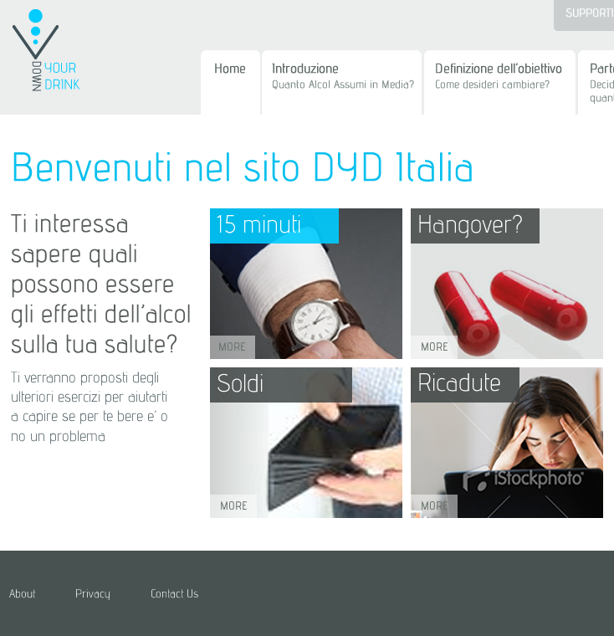
EFAR: effectiveness of facilitated access to alcohol reduction websites
  EFAR FVG
  non-inferiority RCT of eBI vs face-to-face intervention
  funded by Italian Ministry of Health
  run by Piero Struzzo in Friuli-Venezia-Giulia, Italy

Slide 66
Aim of the EFAR FVG study
Overall: To evaluate whether online GP facilitated access to an alcohol reduction website for at-risk drinkers is as effective as face-to-face brief intervention conducted by GPs
Pilot: To test the feasibility of the trial design

Slide 67
The EFAR FGV trial – key features
Participating GPs are all in the Italian Region of Friuli Venezia Giulia (FVG)
GPs role is to actively promote the use of the alcohol screening component of the health website – Ti Vuoi Bene? www.itatvb.it
On-line consent, assessment, randomisation and follow-up
Comparison is between face to face and online intervention for risky drinkers
Effect size to be excluded: 10% difference
Required sample size - 1000 patients per country

Slide 68
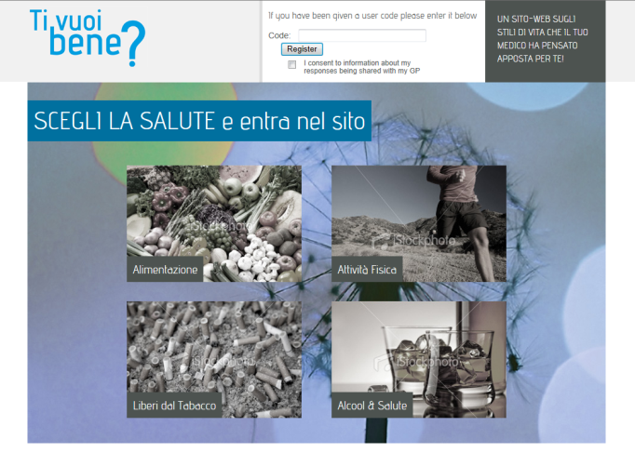
GP facilitated online recruitment via the “Ti Vuoi Bene?” brochure and website
Active distribution by GPs of brochure with personalised log-in code
Code provides access to www.itatvb.it with screening module using the AUDIT-C
Cut point of 5 used to identify risky drinkers
Those scoring at or above cut point invited to take part in study

Slide 69
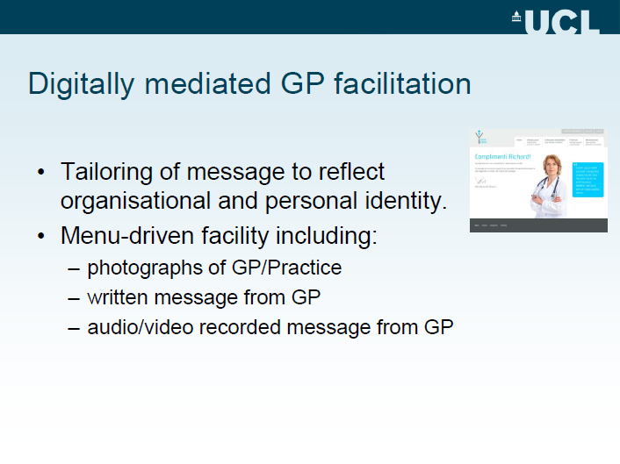

Slide 70
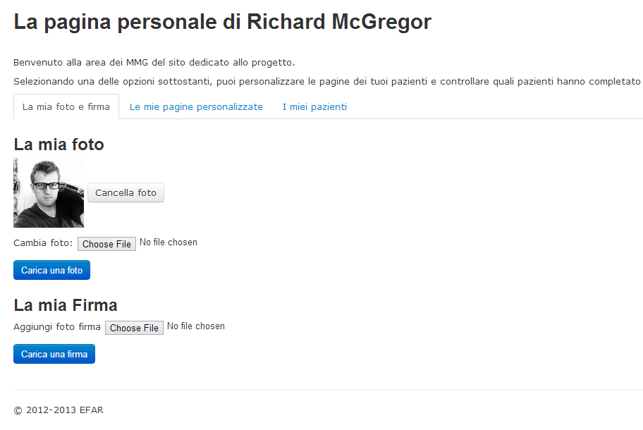
GP on-line personalisation facility
Includes ability for GPs to personalise feedback text and upload their photo and signature

Slide 71
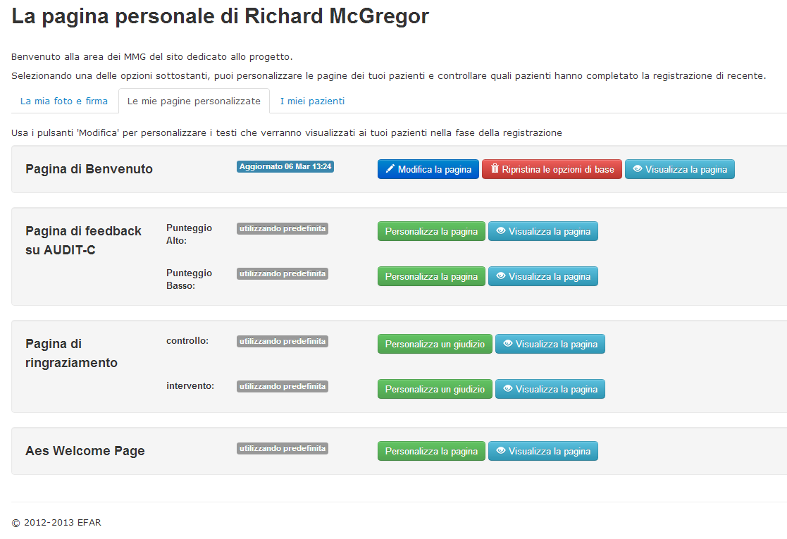
GP on-line personalisation facility:
There are several GP personalisation sections

Slide 72
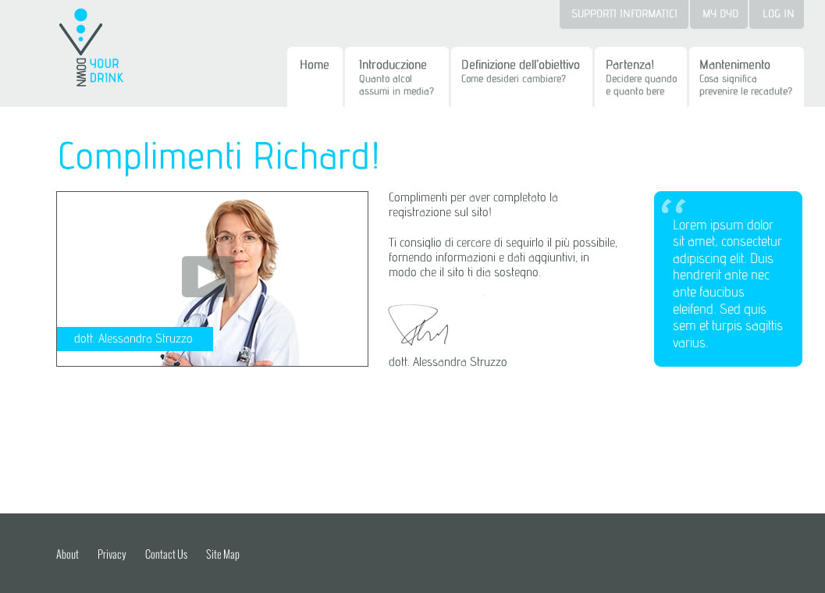
Digitally mediated GP messaging – with video

Slide 73
Stage1: Brochure distribution, online screening, consent, assessment, randomisation
Patients screened online with AUDIT-C
Patients given a brochure with unique log-on code
Consent, baseline assessment and randomisation on-line
RECRUITMENT USING BROCHURE WITH LOG-ON CODE FOR WESBITE
ON-LINE SCREENING
ON-LINE RECRUITMENT

Slide 74
online facilitated access
1m
(pilot only)
3m
12m
ANALYSIS
RANDOMISATION
FOLLOW-UP
Cost-effectiveness
face-to-face
AUDIT 10 and EQ5D
Cost per QALY
Stage 2: Randomisation, follow-up and analysis
Notes:
After baseline assessment with the ten-question AUDIT and EQ-5D questionnaires, they will be randomly assigned to receive either online facilitated access to the alcohol reduction website (intervention) or face-to-face intervention based on the brief motivational interview by their GPs (control).
Follow-up will take place and the outcome will be calculated on the basis of the proportion of risky drinkers in each group according to the AUDIT-10.
Analysis will be performed to determine the cost-effectiveness of patients receiving the online intervention compared to conventional face-to-face brief intervention by the GPs. Cost-effectiveness will be calculated as cost per quality adjusted life year (QALY) gained using the EQ-5D.

Slide 75
The pilot study (Jan 2013 - June 2013)
PILOT
MAIN TRIAL
ANALYSIS
ADJUST-MENTS
Notes:
The pilot phase of the trial was launched in January 2013 and the one-month follow up was carried out in February 2013. Twelve practices have recruited patients since then and more than a thousand leaflets have been distributed. The pilot will be completed in May 2013 and the full findings will be presented. Outcomes will be calculated on the basis of the proportion of risky drinkers in each group.

Slide 76

Distribution of brochures, patient log-ons, AUDIT-C activity, and randomisation by practice
Practice Code | Brochures | Patient Log on (% of brochures) | AUDIT-C (% of log on) | Risky (% of AUDIT-C) | Randomised (% of Risky)
001 | 43 | 21 (49) | 20 (95) | 11 (55) | 8 (73)
002 | 80 | 43 (54) | 39 (91) | 2 (5) | 2 (100)
003 | 90 | 47 (52) | 43 (91) | 10 (24) | 8 (80)
004 | 205 | 82 (40) | 74 (90) | 12 (16) | 12 (100)
005 | 280 | 90 (32) | 88 (98) | 13 (15) | 13 (100)
006 | 113 | 74 (65) | 69 (92) | 17 (25) | 15 (88)
007 | 140 | 50 (36) | 48 (96) | 9 (19) | 9 (100)
008 | 32 | 19 (59) | 18 (95) | 4 (22) | 2 (50)
009 | 147 | 27 (18) | 27 (100) | 9 (33) | 7 (78)
010 | 32 | 31 (97) | 25 (81) | 2 (8) | 2 (100)
011 | 143 | 61 (43) | 59 (97) | 15 (25) | 10 (67)
013 | 22 | 17 (77) | 14 (82) | 2 (14) | 1 (50)
Total | 1327 | 562 (42) | 524 (93) | 106 (20) | 89 (84)
.
Notes:
I medici 11 e 12 hanno iniziato in reclutamento circa 1 mese dopo gli altri, perché invitati dopo a partecipare. Non hanno frequentato in corso, hanno ricevuto le istruzioni dal dr. Struzzo.
Variabilità di quantità di brochure per vari motivi: diverso impegno personale, diversa strategia (a tappeto (005) versus selezione dei pazienti (001) cui consegnare la brochure). In media sono state distribuite 110 brochure (mediana 102)
Il 42% dei pazienti che hanno ricevuto una brochure hanno fatto l’accesso al sito con il numero di log-in presente sulla brochure consegnata (in media circa 47 pazienti per ogni medico)
Non tutti hanno compilato l’AUDIT-C (93%)
Il 20% di quelli che hanno compilato l’AUDIT-C sono risultati a rischio e quindi gli è stato proposto di proseguire.
Ma solo 89 di essi hanno completato il modulo di baseline indispensabile per la prosecuzione e preliminare alla randomizzazione.
Risulta perciò che il 16% dei pazienti che hanno avuto accesso al sito hanno completto il baseline e sono stati randomizzati. (circa 7,42 per medico)

Slide 77
Randomisation and follow-up at 1 month and 3 months
Practice Code | Randomised | Face to Face (% of randomised) | Facilitated access (% of randomised) | 1 month FU completed (% total) | 3 month FU completed (% total)
001 | 8 | 5 (62) | 3 (38) | 7 (88) | 7 (88)
002 | 2 | 1 (50) | 1 (50) | 1 (50) | 1 (50)
003 | 8 | 4 (50) | 4 (50) | 7 (88) | 7 (88)
004 | 12 | 7 (58) | 5 (42) | 12 (100) | 12 (100)
005 | 13 | 9 (69) | 4 (31) | 11 (85) | 11 (85)
006 | 15 | 11 (73) | 4 (27) | 15 (100) | 14 (93)
007 | 9 | 5 (56) | 4 (44) | 4 (44) | 4 (44)
008 | 2 | 1 (50) | 1 (50) | 0 (0) | 0 (0)
009 | 7 | 5 (71) | 2 (29) | 3 (43) | 3 (43)
010 | 2 | 0 (0) | 2 (100) | 2 (100) | 1 (50)
011 | 10 | 4 (40) | 6 (60) | 8 (80) | 7 (70)
013 | 1 | 0 (0) | 1 (100) | 0 (0) | 0 (0)
Total | 89 | 52 (58) | 37 (42) | 70 (79) | 67 (75)
Notes:
Degli 89 pazienti del trial, tutti sono stati invitati a completare il follow-up del primo e del terzo mese.
Il follow-up del primo mese è stato completato dal 79% dei pazienti mentre il follow-up del terzo mese è stato completato dal 75% dei pazienti, invitati.

Slide 78
Exposure by trial participants to randomised condition
Practice Code | Randomised to face to face | Face to face intervention received (%) | Randomised to website | Registered to website (%) | Viewed >2 pages (%) | Viewed >10 pages (%)
001 | 5 | 4 (80) | 3 | 3 (100) | 2 (67) | 1 (33)
002 | 1 | 1 (100) | 1 | 0 (0) | 0 (0) | 0 (0)
003 | 4 | 0 (0) | 4 | 3 (75) | 2 (50) | 2 (50)
004 | 7 | 7 (100) | 5 | 3 (60) | 2 (40) | 1 (20)
005 | 9 | 8 (89) | 4 | 3 (75) | 2 (50) | 2 (50)
006 | 11 | 11 (100) | 4 | 3 (75) | 2 (50) | 2 (50)
007 | 5 | 0 (0) | 4 | 4 (100) | 2 (50) | 2 (50)
008 | 1 | 0 (0) | 1 | 1 (100) | 1 (100) | 1 (100)
009 | 5 | 1 (20) | 2 | 1 (50) | 1 (50) | 0 (0)
010 | 0 | 0 (0) | 2 | 2 (100) | 1 (50) | 1 (50)
011 | 4 | 2 (50) | 6 | 4 (67) | 4 (67) | 3 (50)
013 | 0 | 0 (0) | 1 | 1 (100) | 1 (100) | 0 (0)
Total | 52 | 34 (65) | 37 | 28 (76) | 21 (75) | 15 (54)

Slide 79
Conclusions from EFAR FVG pilot
Overall performance of the trial is acceptable
GP facilitated online recruitment using brochures is feasible, but variable (22 - 280)
On-line screening via TVB website is generally effective (~20%)
Most screen +ve patients go on to provide consent & complete baseline assessment (84%)
Online randomisation is feasible
Follow-up rates are generally good (1m ~ 80%, 3m ~75%)

Slide 80
Where are we now?
Main trial started 20.1.014
PILOT
MAIN TRIAL
ANALYSIS
ADJUST-MENTS
Notes:
The pilot phase of the trial was launched in January 2013 and the one-month follow up was carried out in February 2013. Twelve practices have recruited patients since then and more than a thousand leaflets have been distributed. The pilot will be completed in May 2013 and the full findings will be presented. Outcomes will be calculated on the basis of the proportion of risky drinkers in each group.

Slide 81
EFAR FVG – main trial recruitment*
Practice Code% | Name | Customisation | N last Brochures | Baseline Started | % | Risky | % | Baseline Completed | % | Control | % | Intervention | %
027 | Gianni Iacuzzo | Y | 148 | 80 | 54 | 12 | 15 | 12 | 100 | 8 | 67 | 4 | 33
041 | Maria Angela Bravo | N | 102 | 39 | 38 | 12 | 31 | 11 | 92 | 8 | 73 | 3 | 27
023 | Carmelo Matera | Y | 61 | 30 | 49 | 12 | 40 | 11 | 92 | 3 | 27 | 8 | 73
080 | Pierina revignas | N | 113 | 54 | 48 | 10 | 19 | 10 | 100 | 7 | 70 | 3 | 30
081 | Ciro mamolo | Y | 82 | 46 | 56 | 10 | 22 | 10 | 100 | 8 | 80 | 2 | 20
038 | Rossana Sellibara | Y | 109 | 20 | 18 | 11 | 55 | 10 | 91 | 7 | 70 | 3 | 30
025 | Tiziano Ermacora | Y | 184 | 80 | 43 | 9 | 11 | 9 | 100 | 4 | 44 | 5 | 56
030 | Massimo Toffolo | N | 98 | 30 | 31 | 10 | 33 | 9 | 90 | 2 | 22 | 7 | 78
032 | Benyamin Moshe Chamouni | Y | 97 | 30 | 31 | 8 | 27 | 7 | 88 | 2 | 29 | 5 | 71
082 | Elisabetta zappalà | Y | 76 | 28 | 37 | 7 | 25 | 7 | 100 | 3 | 43 | 4 | 57
089 | Carlo Miotti | Y | 62 | 26 | 42 | 8 | 31 | 7 | 88 | 3 | 43 | 4 | 57
045 | Egidio Castellarin | Y | 33 | 21 | 64 | 7 | 33 | 7 | 100 | 3 | 43 | 4 | 57
033 | Gianfranco Panizzo | Y | 108 | 35 | 32 | 6 | 17 | 6 | 100 | 4 | 67 | 2 | 33
037 | Ivana Rupalti | Y | 120 | 59 | 49 | 6 | 10 | 5 | 83 | 3 | 60 | 2 | 40
079 | Raffaella Principato | Y | 94 | 38 | 40 | 6 | 16 | 5 | 83 | 4 | 80 | 1 | 20
028 | Adriana Fasiolo | N | 81 | 28 | 35 | 5 | 18 | 5 | 100 | 4 | 80 | 1 | 20
042 | Gianna Bunello | Y | 102 | 23 | 23 | 6 | 26 | 5 | 83 | 2 | 40 | 3 | 60
036 | Laura Ivana Tonelli | Y | 86 | 13 | 15 | 5 | 38 | 5 | 100 | 1 | 20 | 4 | 80
059 | Nelly Drigani | N | 57 | 20 | 35 | 4 | 20 | 4 | 100 | 2 | 50 | 2 | 50
050 | Maria Pia Cisilin | Y | 97 | 17 | 18 | 4 | 24 | 4 | 100 | 1 | 25 | 3 | 75
051 | Lucia casatta | Y | 38 | 13 | 34 | 4 | 31 | 4 | 100 | 3 | 75 | 1 | 25
060 | Giosuè Acampora | Y | 171 | 46 | 27 | 3 | 7 | 3 | 100 | 2 | 67 | 1 | 33
026 | Clemente Condello | N | 13 | 7 | 54 | 3 | 43 | 3 | 100 | 1 | 33 | 2 | 67
048 | Alessandro Falcidia | N | 107 | 52 | 49 | 3 | 6 | 2 | 67 | 1 | 50 | 1 | 50
087 | Chiara Toffoletti | Y | 97 | 18 | 19 | 2 | 11 | 2 | 100 | 0 | 0 | 2 | 100
058 | Gianni Tubaro | Y | 74 | 16 | 22 | 3 | 19 | 2 | 67 | 0 | 0 | 2 | 100
083 | Simone Trevisani | Y | 131 | 12 | 9 | 2 | 17 | 2 | 100 | 2 | 100 | 0 | 0
040 | Francesca Pighin | Y | 12 | 10 | 83 | 2 | 20 | 2 | 100 | 1 | 50 | 1 | 50
020 | Antonio Zappi | Y | 2 | 2 | 100 | 2 | 100 | 2 | 100 | 2 | 100 | 0 | 0
039 | Giuseppe Latella | Y | 28 | 11 | 39 | 1 | 9 | 1 | 100 | 1 | 100 |  | 0
085 | Chiara Bregant | Y | 24 | 11 | 46 | 1 | 9 | 1 | 100 | 0 | 0 | 1 | 100
049 | Gianfranco Silverii | N | 18 | 9 | 50 | 1 | 11 | 1 | 100 | 0 | 0 | 1 | 100
024 | Roberto Troisi | Y | 26 | 7 | 27 | 1 | 14 | 1 | 100 | 1 | 100 | 0 | 0
043 | Isabella Milan | Y | 21 | 6 | 29 | 1 | 17 | 1 | 100 | 0 | 0 | 1 | 100
022 | Raffaella Milanese | N | 5 | 1 | 20 | 1 | 100 | 1 | 100 | 1 | 100 | 0 | 0
086 | Lucia Mei | Y | 22 | 9 | 41 | 1 | 11 | 0 | 0
063 | Michela Sereni | N | 31 | 3 | 10 | 0 | 0
044 | Roberto Vallini | N | 2 | 1 | 50 | 0 | 0
021 | Mauro Gubbiani | N | 0 | 0
034 | Leila Tommasin | N | 0 | 0
035 | Francesca Romano | N | 0 | 0
062 | Maurizio Ciccone | N | 0 | 0
 | Totals |  | 2732 | 951 | 35% | 189 | 20% | 177 | 94% | 94 | 53% | 83 | 47%
*14th February 2014 ie 3 weeks

Slide 82
Current status of EFAR trials
Italy : EFAR FVG – pilot completed and main trial commenced
Spain: EFAR-Spain – in planning stage. Inaugural meeting for GPs on 25th April
Australia: DYD-Australia submission to NHMRC to be further developed
UK – EFAR-UK in planning stage with Bridgette Bewick and Eileen Kaner

Slide 83
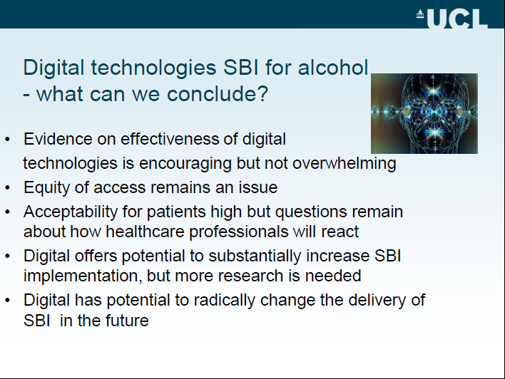

Slide 84


The future for digital technologies and SBI for alcohol
“The convergence of biology and engineering is turning health care into an information industry. That will be disruptive
but also hugely beneficial to patients”
Vijay Vaitheeswaran Apr 16th 2009

Slide 85
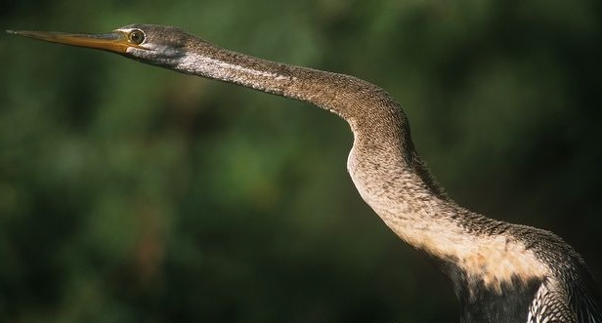
Predictions…..
Digital will increasingly be
used in training for SBI
Digital will increasing be used to deliver SBI in a wide range of settings eg: health and social care,. criminal justice, the workplace
Digital will increasingly be embedded in primary healthcare setting through the Virtual General Practice environment

Slide 86
Thank you!

Slide 88
Work package 5
Cluster randomised controlled trial to assess effect of a number of factors on implementation of evidence-based methods of identification and brief intervention for excessive alcohol consumption in routine primary health care.

Slide 89

Cluster randomisation – the 8 groups
Group | CME (education) | Economic re-imbursement | BI over internet
1 | - | - | -
2 | + | - | -
3 | - | + | -
4 | - | - | +
5 | + | + | -
6 | + | - | +
7 | - | + | +
8 | + | + | +
WP5

Slide 90
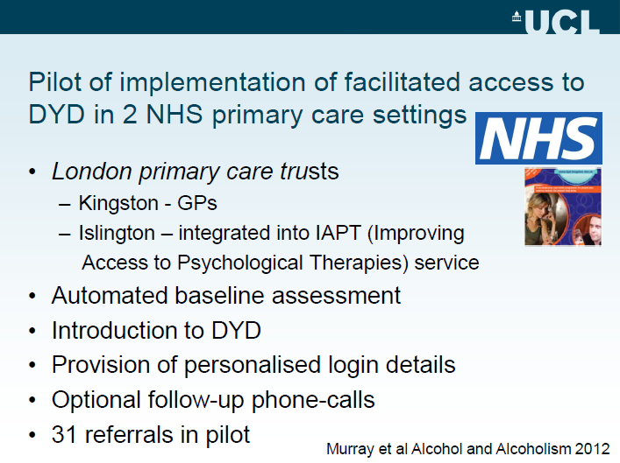

Slide 91
ODHIN eBI : preliminary findings - London
Centre | Practitioner ID | Total patients screened positive | Total e-BI referrals in Implementation Period | Total patients logged on | Proportion of screen +ve patients referred to e-BI | Proportion of referred patients that logged on
London | 1301 | 7 | 7 | 2 | 1.000 | 0.286
London | 1302 | 2 | 1 | 0 | 0.500 | 0.000
London | 1303 | 3 | 2 | 0 | 0.667 | 0.000
London | 1304 | 3 | 0 | 0 | 0.000
London | 1501 | 5 | 3 | 0 | 0.600 | 0.000
London | 1502 | 1 | 1 | 1 | 1.000 | 1.000
London | 1503 | 16 | 10 | 3 | 0.625 | 0.300
London | 1504 | 4 | 2 | 0 | 0.500 | 0.000
London | 1601 | 12 | 12 | 1 | 1.000 | 0.083
London | 1602 | 6 | 5 | 1 | 0.833 | 0.200
London | 1603 | 5 | 0 | 0 | 0.000
London | 1801 | 0 | 0 | 0 | 0.000
London | 1802 | 0 | 0 | 0 | 0.000
London | 1803 | 4 | 2 | 0 | 0.500 | 0.000
London | 1804 | 10 | 7 | 0 | 0.700 | 0.000

