Slide 1
Session 9:
Conflict resolution and Security Council Resolution 1325
Refugee women in leadership:
Power through participation

Slide 2
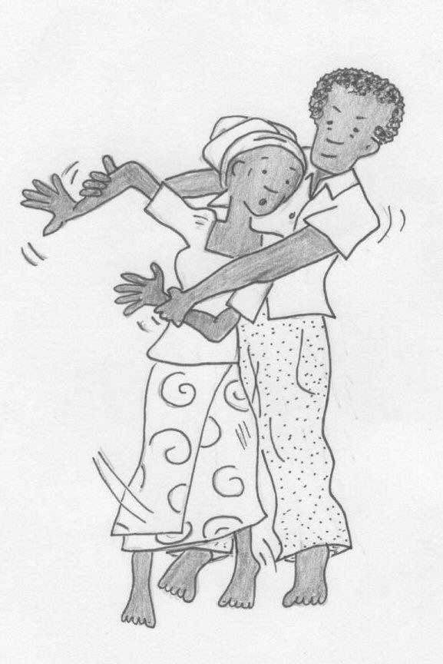
Conflict resolution
How can women help resolve conflict in their families and communities?

Slide 3
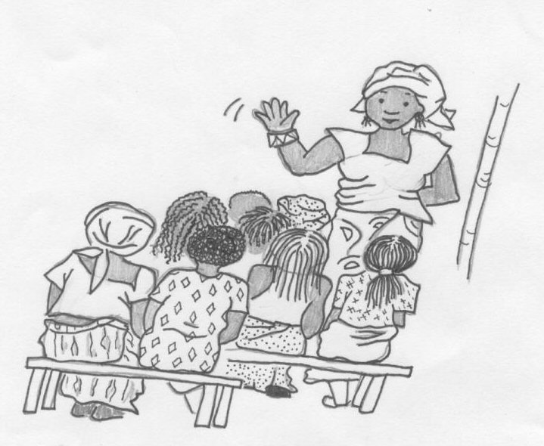
Conflict resolution
What skills do we need to learn to help us resolve conflicts?

Slide 4
Causes of conflict
Bad communication
Power imbalances caused by class or age differences, sexism or racism
Lack of information
Insensitivity
Different viewpoints
Lack of time to deal with an issue

Slide 5
What causes conflict in…
The family?
The community?
The camp or settlement?
The world?

Slide 6
Conflict resolution skills
Good listening skills
Good communication
Trying to understand both sides of an argument
Being fair and unbiased
Being willing to speak the truth
Being assertive not aggressive
Others?

