Slide 1
Session 8:
What is advocacy?
Refugee women in leadership:
Power through participation

Slide 2
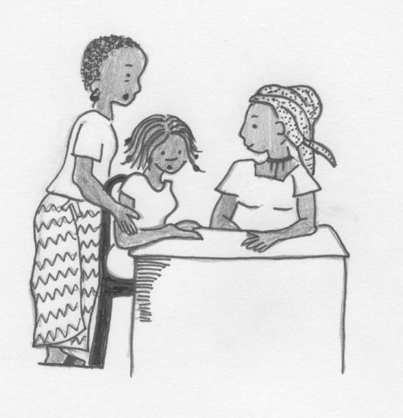
What is advocacy?
Advocacy is about working to bring about positive change, for ourselves or others.
Lobbying is part of advocacy – it is about persuading people who have the power to bring about change.

Slide 3
What is advocacy?
Advocacy can be local, national or international.

Slide 4
Types of advocacy
Seeking meetings with people in power
Writing letters to people who may be able to help
Speaking out about injustice whenever it is safe to do so
Attending meetings and having your voice heard
Community education
Suggesting achievable solutions
Taking opportunities to go outside the community to present your case or the case of those you are advocating for and with
Documenting human rights violations

