Slide 1
Session 7:
Sharing stories and identifying human rights abuses
Refugee women in leadership:
Power through participation

Slide 2
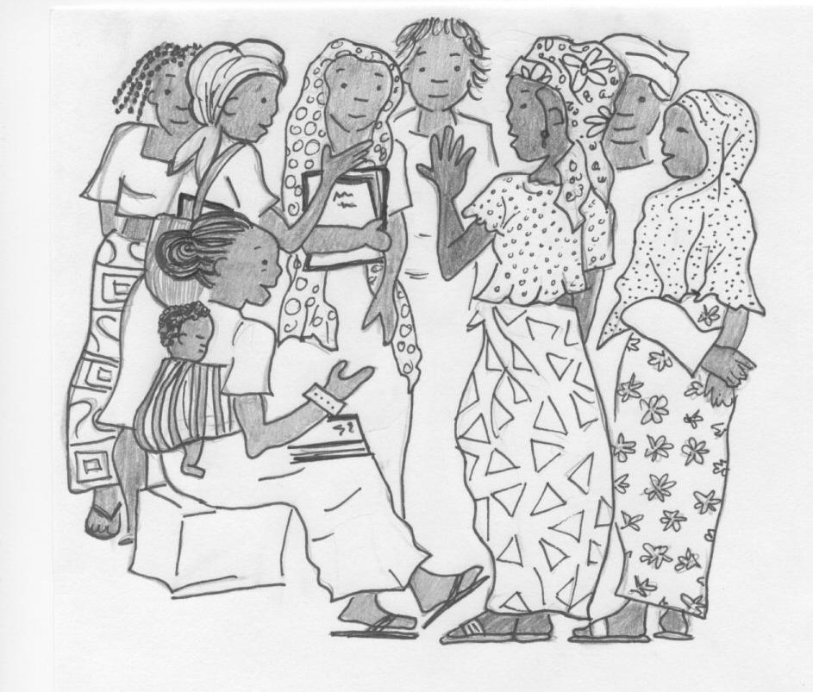
How can you use the BPFA?
How many of the issues in the BPFA are important to you?

Slide 3
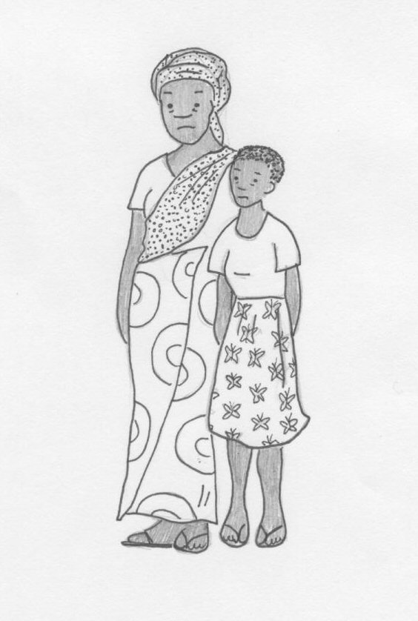
Identifying human rights abuses
Identifying human rights abuses for women and girls.

Slide 4
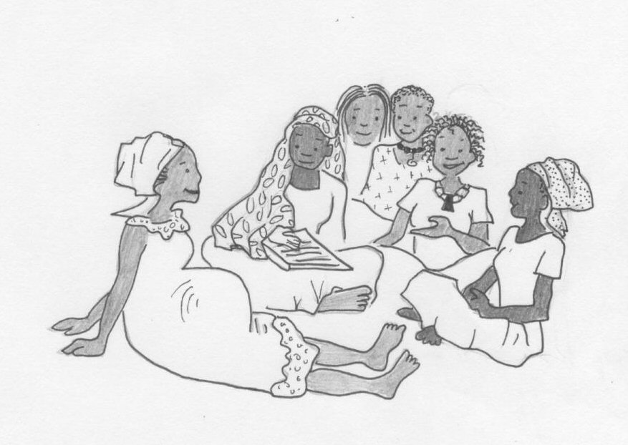
Sharing our stories
Sharing stories of refugee women and girls:
Our stories and others’ stories
Stories of human rights abuses

Slide 5
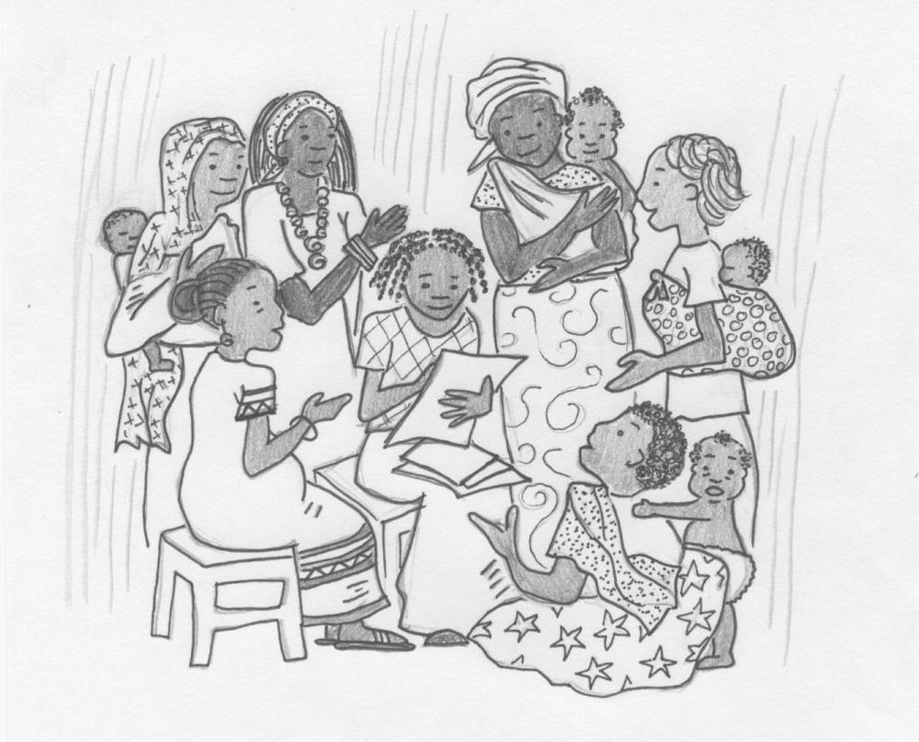
Building trust
Working together and sharing our stories builds trust.

Slide 6
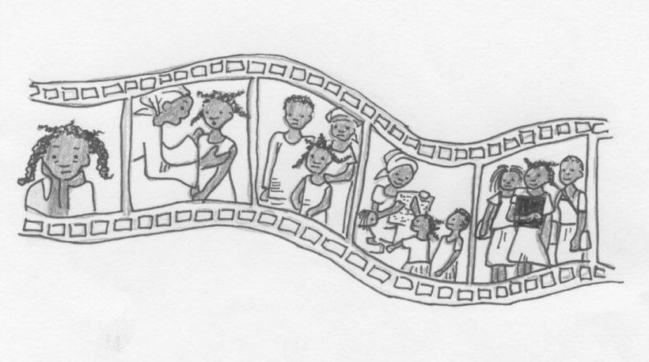
Working together
Listening, thinking and acting to help other women and girls.

