Slide 1
Session 4:
Social identity
Refugee women in leadership:
Power through participation

Slide 2
What is social identity?
We all have many identities.
Different people see us in different ways.
The way people see us affects how they treat us.
We respond to the ways in which people treat us.

Slide 3
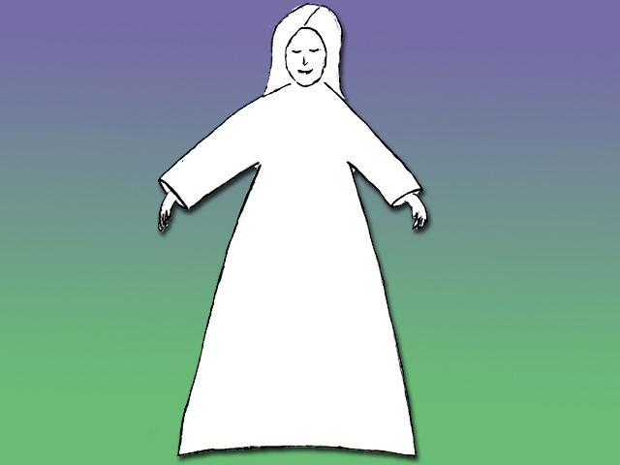
Refugee
Woman
Teacher
Poor
Muslim
Frightened
Non English Speaker
Protector
Wife & Daughter
Victim
Strong
Mother
Vulnerable
Head of Family
Dependent Upon Charity

Slide 4
Refugee
Woman
Raped woman
Poor
Frightened
Victim
Vulnerable
Dependent Upon Charity
Non English Speaker

Slide 5
Refugee
Woman
Muslim
Teacher
Community Leader
Protector
Wife & Daughter
Strong
Mother
Head of Family

Slide 6
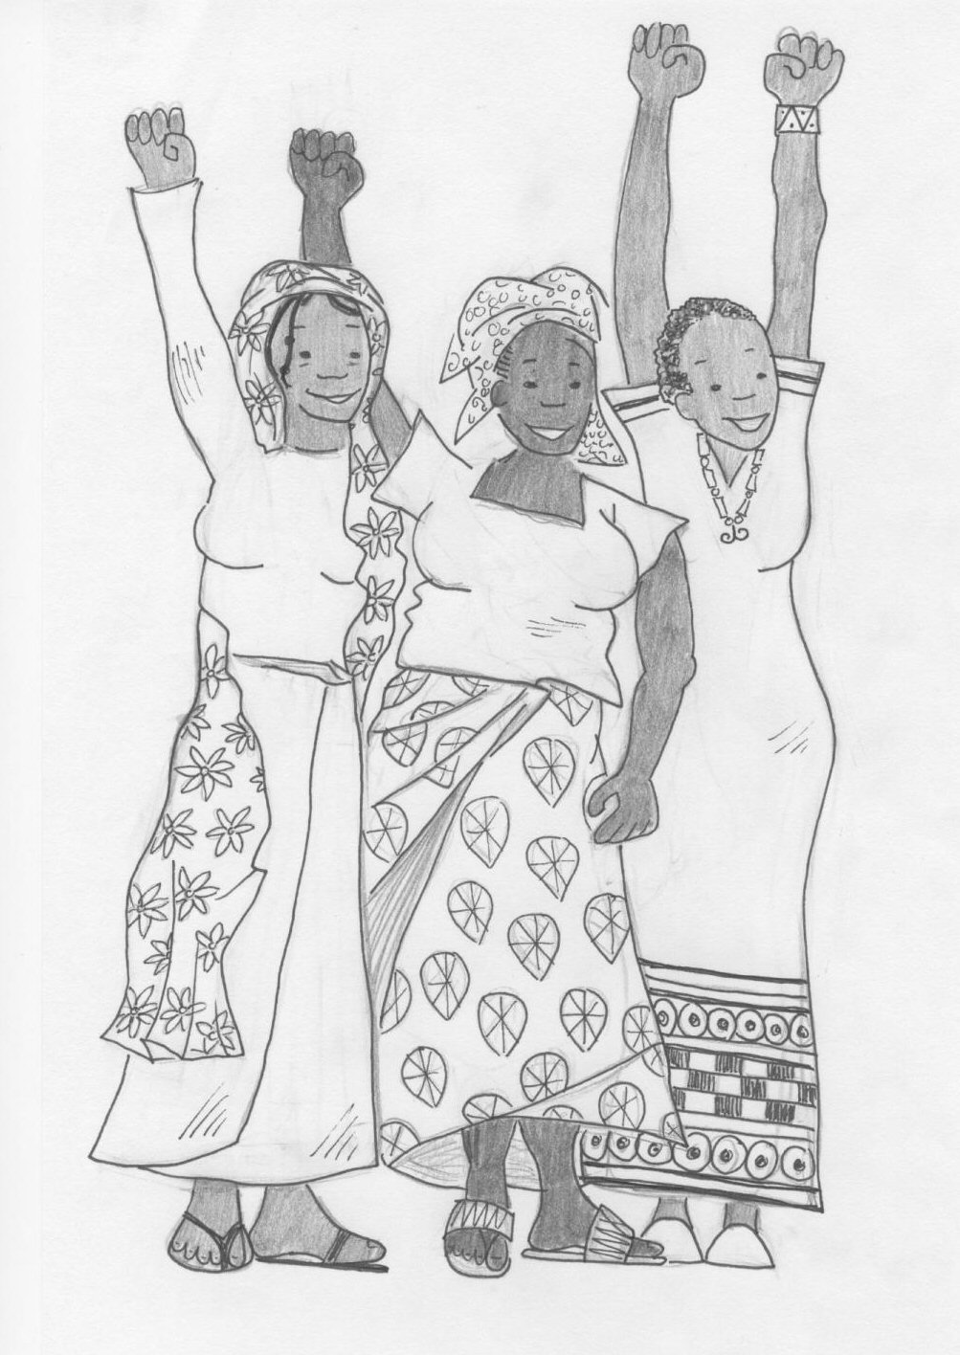
We must wear our ‘leadership label’.
We need to identify as leaders and act as leaders.

