Slide 1
Session 3:
What is gender?
Refugee women in leadership:
Power through participation

Slide 2
What is gender?
What is sex?

Slide 3
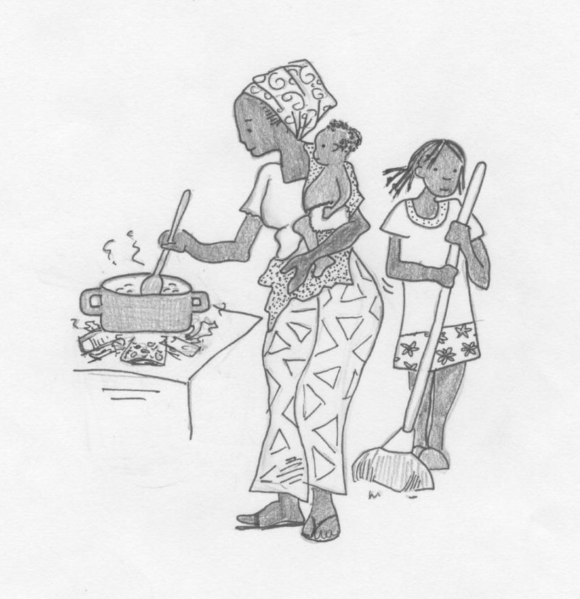
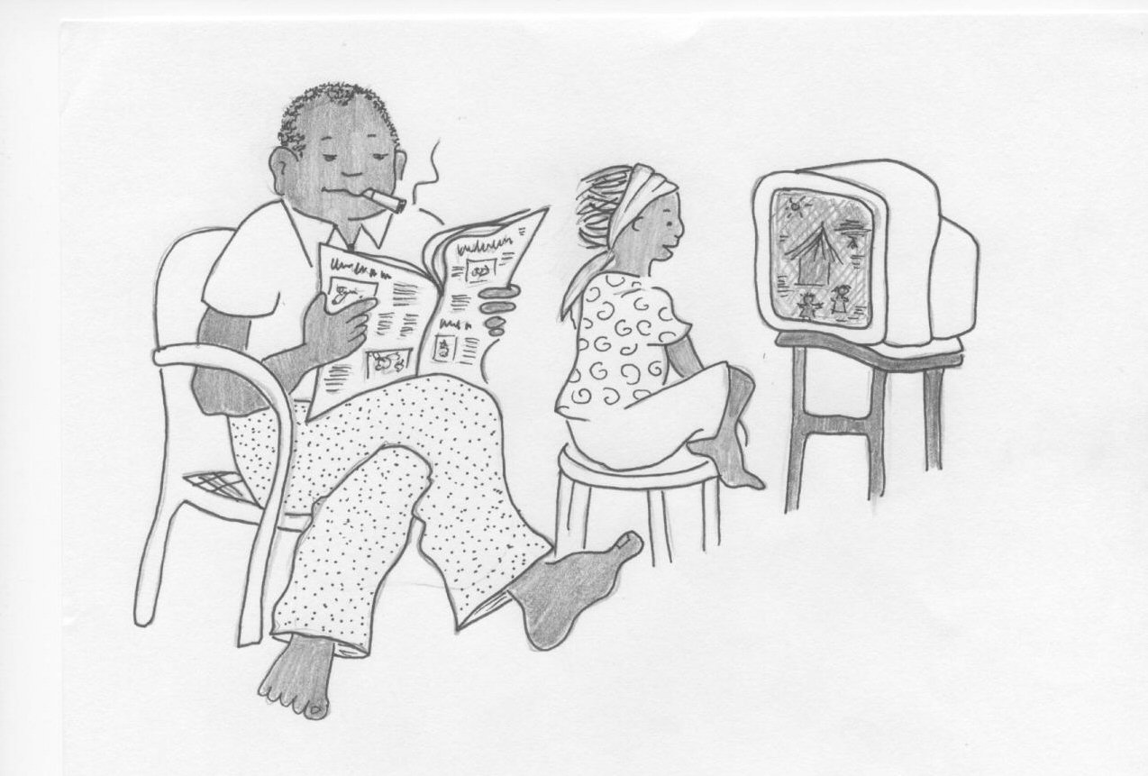
Gender differences
Identify the differences between men/boys and women/girls due to the following:
Culture
Religion
Law
Resources
Power relations

Slide 4
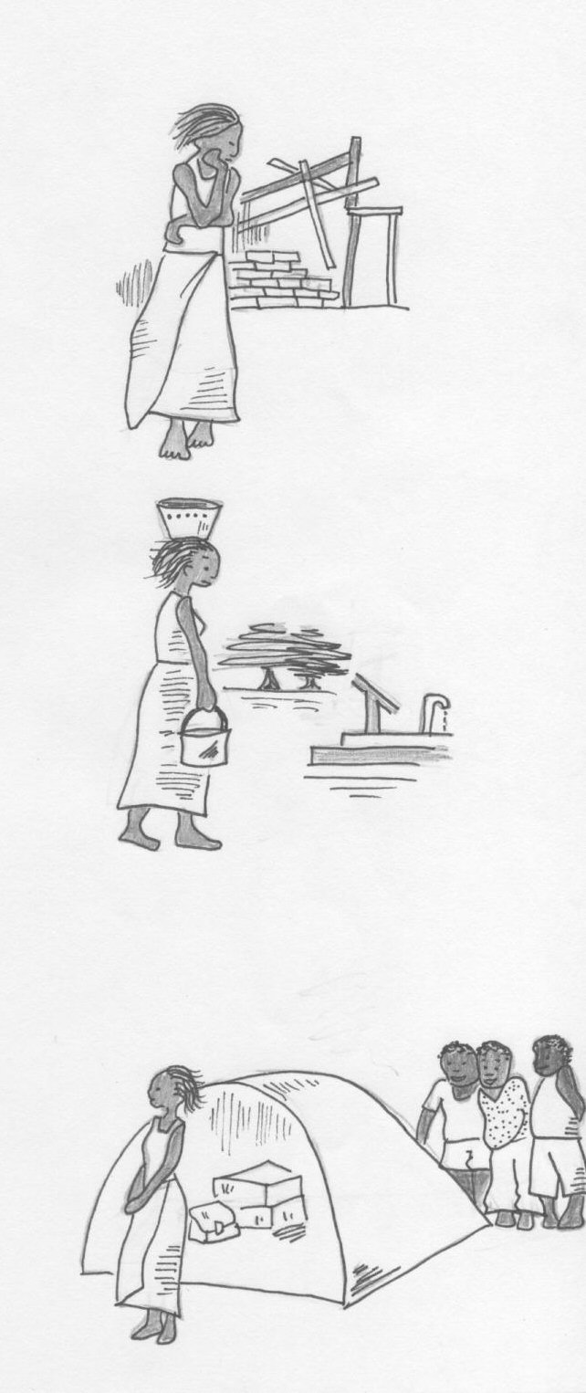
Gender inequality
In what ways does gender inequality impact on women and girls?
1.
2.
3.
and more?

Slide 5
How does culture affect women’s lives?
How did culture affect women’s lives in your home country?
Did the conflict change this?
How does culture affect women’s lives in the camp or settlement?

Slide 6
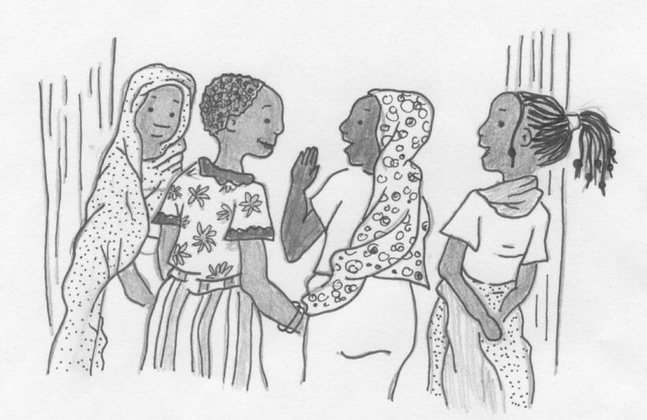
Overcoming gender discrimination
How do these differences in treatment create difficulties for women leaders?
How do we overcome this?

