Slide 1
Session 2:
What is leadership?
Why do we need women leaders?
Refugee women in leadership:
Power through participation
Notes:
Activities for Session 2
Slide based presentation
Brainstorming
Small group Discussion
Setting Group Objectives for this training course

Slide 2
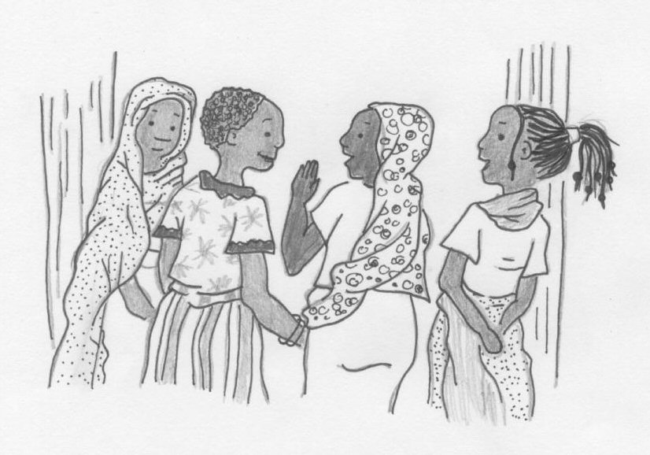
Human beings live and work in groups.
Notes:
Discussion point.
Groups are any gathering of human beings. It can range from a very small family group, a group of friends, a village, a tribe, a refugee camp, an ethnic group, a religious group, a school group, a national group etc.
Introduce the idea of groups and that this training is one example of a group.
Ask them WHY this is a group
Write the responses onto a Flip Chart

Slide 3
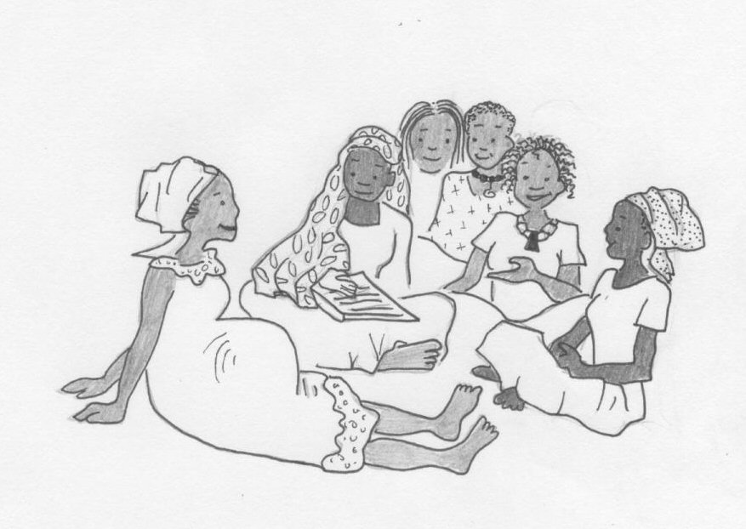
There are many different kinds of groups.
Families
Tribes
Communities
Religious groups
Others?
Notes:
Discussion Continued
Brainstorm the groups that the women belong to.
Write them on to the Flip Chart

Slide 4
People take many roles in groups.
These include:
Leaders
Support people
Group clown
Troublemaker
Peacemaker
Others?
Notes:
Activity
Describe the various roles people take in groups.
Ask them to give examples of how people take different roles.
Discuss how when we take a role, people start to react to us in that role, for example, if we are always quiet, people will not ask our opinion, if we are always arguing, people will avoid talking to us, if we act as a leader, people will treat us as one – give examples from your own experience.
Small Group Exercise:
Give each group member a different role (for example, the group leader, a very quiet person, a trouble maker). Do not let the rest of the group know what role they have been told to take. Each small group member is to act as the role they have been given, rather than as they would normally act.
Note – prepare the roles on slips of paper before you start the exercise. If the women are pre-literate, enlist the role of the interpreters to give them their roles secretly, so that other group members do not know what they have been told.
Now ask the group to make a decision about something relatively important to them. (maybe the design or colour of a Leadership Tee-shirt). When they have completed the exercise, ask the group members which role they thought that other members were taking – then check with the members. In the large group, discuss what it felt like to be in that role.

Slide 5
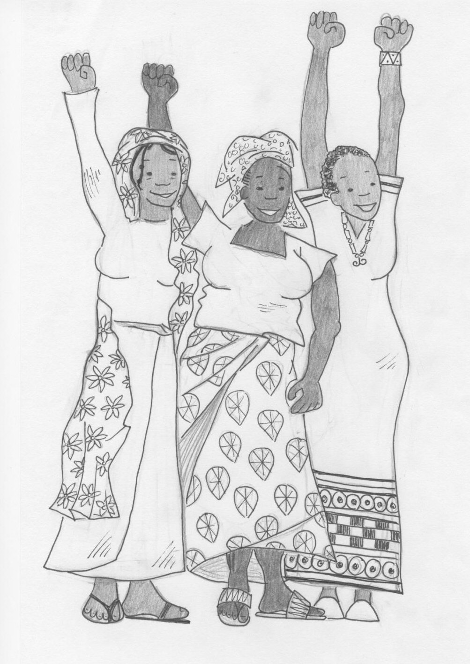
This training is about becoming women leaders.
Notes:
Discussion Continued
Confirm that all participants can develop their leadership skills
Discuss that there are many different kinds of leaders
Brainstorm the various types of leaders they can name
Eg:
Mothers
Head of Family
Head of Womens Groups,
Teachers
Members of camp Committees
Members of CBO;s and NGO’s
Advocates for the refugee community
Women who travel outside the camp to represent their fellow refugees
Write these on a Flip Chart

Slide 6
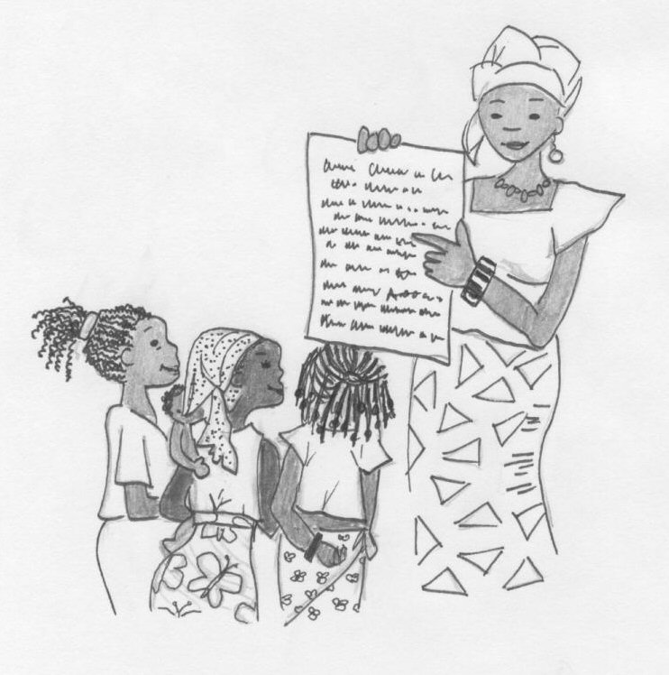
What makes some women leaders?
Notes:
Discussion Continued:
What do the women think makes some women leaders?
Write their suggestions on a Flip Chart
Have you own list prepared in advance.
Include things such as :
Confidence
Family Support
Education
Ability to speak in public
Good self esteem
Skills and Knowledge
A belief in Justice

Slide 7
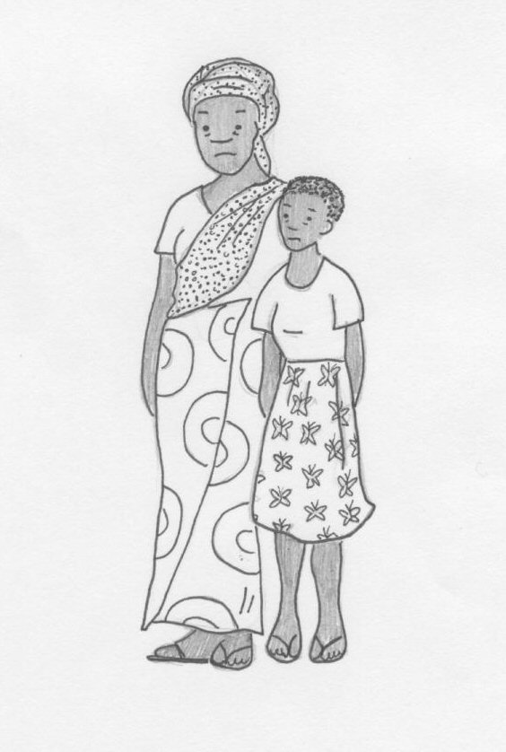
Types of leaders
Some are good and some are bad.
Some are very visible and easy to identify.
Other leaders are quiet but they are respected and people follow their example.
Notes:
Discussion continued:
Go through the list with the group
Either in small groups, or brainstorming, ask the women to discuss the types of leaders which they know.
List what makes a good leader onto the Flip Chart

Slide 8
Types of leaders
Some leaders are formal leaders, such as elders and camp committees.
Some leaders are informal leaders – strong people who are trusted and respected.
Some leaders are not liked and respected, and lead by fear.

Slide 9
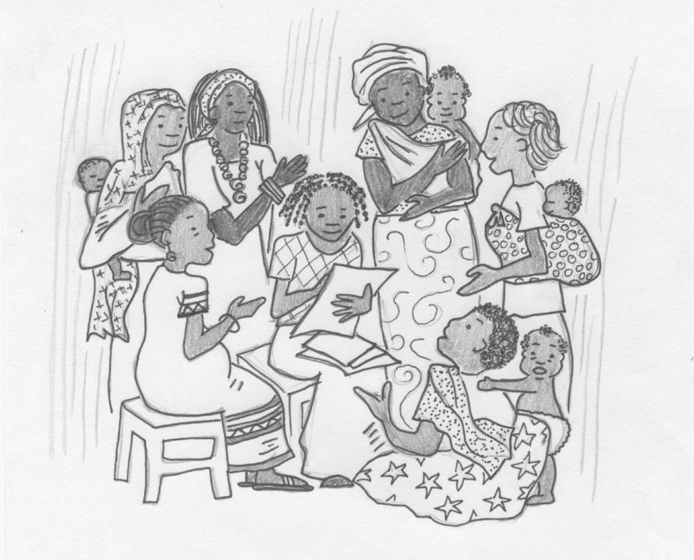
Why do we need WOMEN leaders?
Notes:
Discussion Continued:
Discuss and list why it is important to have women leaders
Write the answers on a Flip Chart Page and put it on the wall for reference during the course

Slide 10
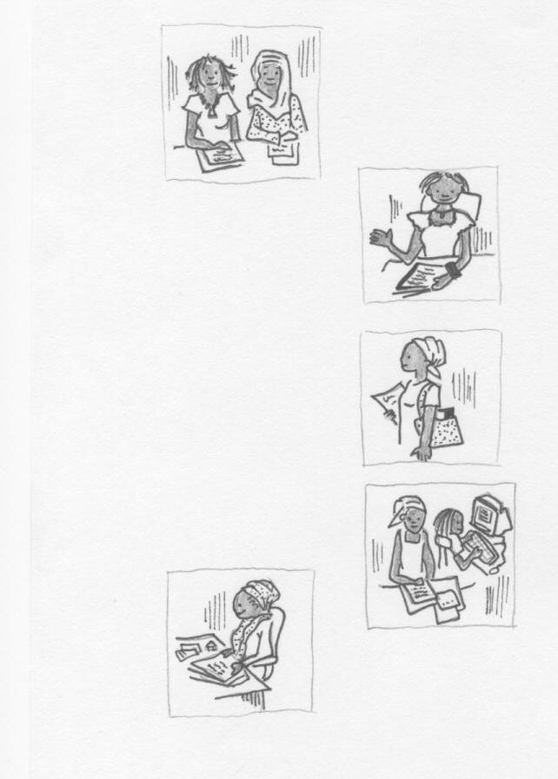
Women in leadership
What leadership roles do women have now?
What other roles could women take?
Notes:
Activity
Small groups exercise
Answer the questions on the slide. Give two copies of the circle diagram (next slide) to each woman and ask them to discuss leadership in the different parts of women's lives. Use one diagram for roles which women currently take and the second one for roles which women could take in the future
In the large group, feedback from the small group discussion and list the answers on two separate flipcharts

Slide 11

Organisations
Community
Family
Society

Slide 12
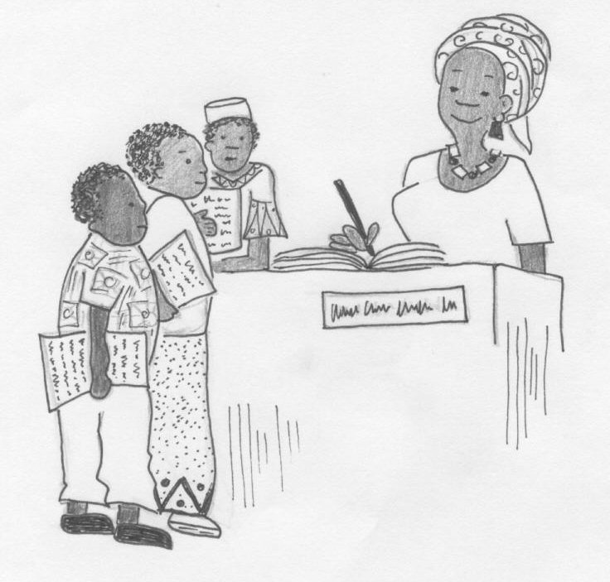
Women in leadership
What support and resources would help women in their work as community leaders?
What training do women need to become leaders?
Notes:
Discussion continued:
Discuss the fact that leaders need some resources and training
List the answers to the questions on the slide either in small groups or by brainstorming.

Slide 13
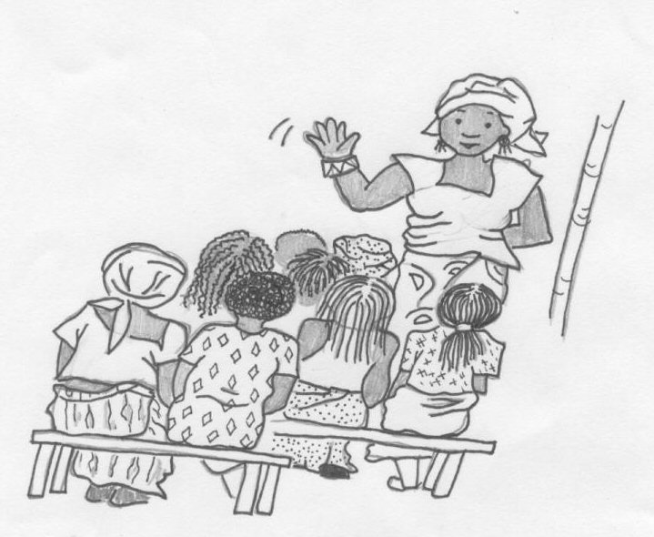
Setting course objectives
What do participants want to learn from this training course?
Notes:
Activity
Ask participants to share what they want to learn from attending this course.
List these on Flip Chart Paper, and discuss what is possible in this training, and what might have to wait for future trainings.
Put the list up on the wall to use in the Training Evaluation on the last day

