Slide 1
Session 10: Assessing needs
Refugee women in leadership:
Power through participation

Slide 2
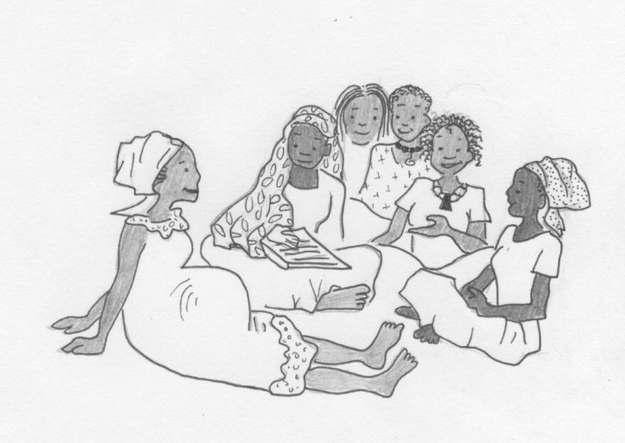
Assessing needs
If you want to find out what people really need you have to ask them!
A good leader will never think that they know what people want and need.

Slide 3
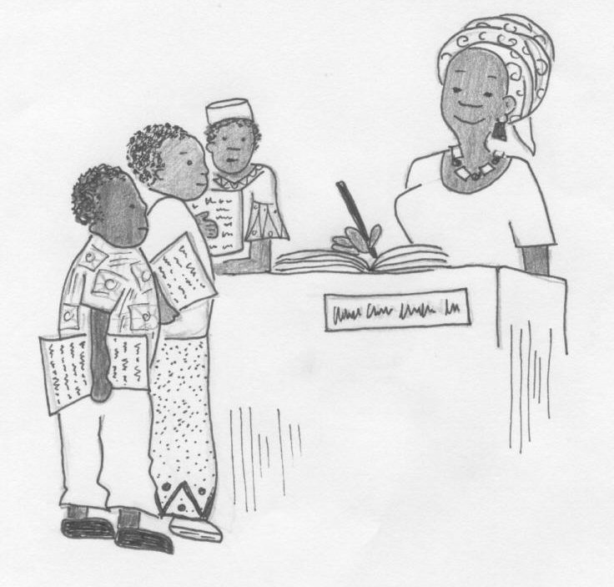
Asking people what they need
This can be done in so many ways, some informal and some formal.

Slide 4
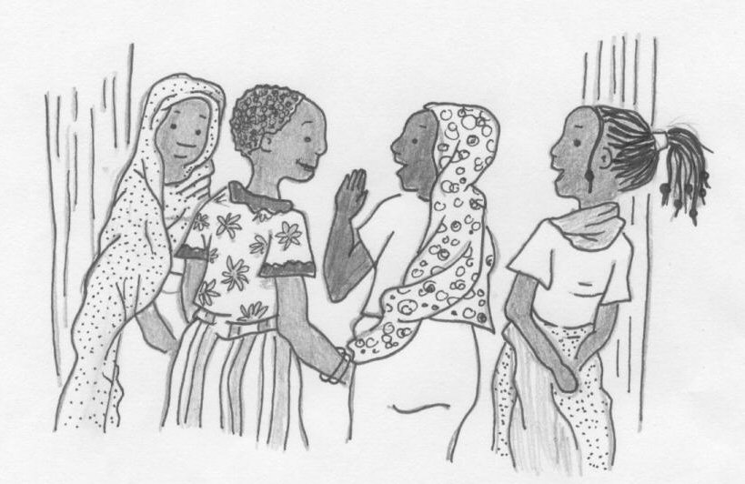
How can you identify what people need?
You may need to get together to do some research and to suggest other ways of identifying what people in your community need.

Slide 5
Make sure you consult everyone!
When doing needs analysis, make sure you consult everyone involved, not just the community leaders.
This includes:
Women and men
Girls and boys
Old people
People with a disability
Single women
Others?

