Slide 1
Refugee Women and Girls, the Key to Implementing Commitments made in the Global Compact on Refugees
Session 1
Structural Barriers For Women Refugee Led Organisations, (WRLOs) Including Lack of Registration.
Developed by Eileen Pittaway and Linda Bartolomei, 2023 The Forced Migration Research Network UNSW
Notes:
Facilitators Notes
In this Session we will:
Identify the major structural barries faced by WRLOs at a local level, including lack of registration.
Trial tools to identify these and develop solutions.

Slide 2
Aims of the Session
The aims of this session are to enable stakeholders to make a realistic assessment of the structural challenges faced by WRLOs in specific contexts, and to plan realistic ways to accommodate or overcome these.
Notes:
Suggested time needed to run the full module.
The material can be introduced in a presentation of one hour, with an additional hour for participants to practise using the tool. However, to do it thoroughly, as a basis for strategic planning participants will need to do research in their own time, to ensure that they have full and accurate information as a basis for their program design.

Slide 3
Structural Issues
These refer to problems that are a result of the biases embedded in the fabric of social institutions, such as education, family, religion, government and economic institutions. It applies both in countries of origin and host countries and may differ in each site. These biases create great advantages for some members of society and major disadvantages for others, who may be already marginalized.
They are said to be designed to provide structure, guidance and order in any given society, and are shaped by ideologies and dominant beliefs.
Notes:
Prepare some examples from your own experience and invite participants to share their own experiences.
Please read the background notes for more detail.

Slide 4
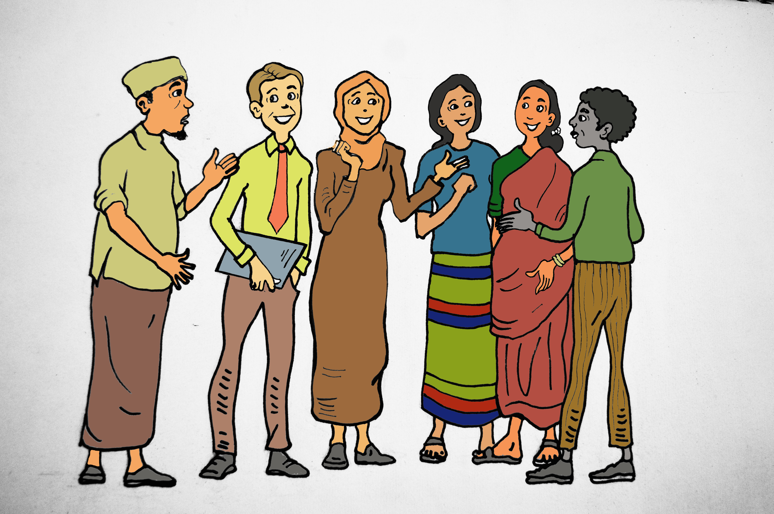
Unregistered and Registered Refugee Led Groups
A major structural impediment to refugee led organisations, in particular WRLOs, is lack of the ability to register their organisations in the countries where they have sought refuge and the impact this has on their ability to function effectively and to receive funding. It presents major problems to their smooth operation, and to receiving funding from major donors. This is very political and must be handled with care and diplomacy.
Notes:
Ask participants what the situation re registration is in the country in which they are currently living.

Slide 5

Pros and Cons
In sites where refugee led organisation are allowed to register, many, but certainly not all of these barriers are addressed, but it is still not easy being a minority group dependent on the good-will of others. These structural issues are beyond the power of refugees to address them alone and need the support for key stakeholders, host and donor governments to bring about change.
Notes:
Do participants have experience of working in or for a registered organisation?
Do they know of any registered refugee led organisations, and if yes, how do these work?

Slide 6
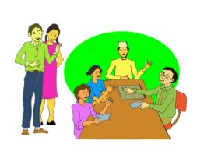
Tools and exercises
We suggest that groups wishing to explore the barriers identified in this resource kit complete the tools and exercises with key stakeholders, and if possible, with representatives from the refugee communities as well as community leaders. Once the exercises are completed the results can be analysed to inform strategic planning, program design, implementation and evaluation when working with registered and unregistered refugee led organisations. They will highlight the different challenges faced by women’s refugee led organisations. This will differ from site to site, dependent on the local socio-political environment.
Notes:
This requires local knowledge and participants might have to do some research and continue the exercises at the next training session.

Slide 7
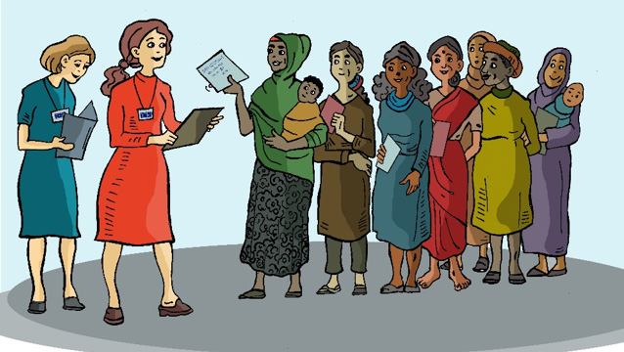
A Tool to examine structural barriers experienced by WRLOs
The Tool is situational analysis designed to assist key stakeholders, including refugee groups, NGOs, INGOs UN Personnel and Donors to clearly identify local structural barriers to RLOs and WRLOS, and potential solutions. It will help decide which model of refugee participation is realistic and viable in any given place, provide evidence for strategic planning and advocacy and guide program design, implementation and evaluation.
Notes:
As above.

Slide 8
Refugee Led organisations
Are/do Refugee Groups: | Yes, No, Partially | If not what, if anything, can be done to change this?
a. Incorporated legally,
b. Have de facto acceptance from local authorities
c. Able to directly receive funding, and have their own bank accounts
d. Work in partnership with a local or international NGO who is willing to auspice the funds on their behalf
e. Allowed by authorities to hold meetings?
f. Have the right to work,
g. Have de facto acceptance of their work status from local authorities,
Notes:
An important aspect of this exercise is exploring to see if anything could be changed. This might be done most effectively in the large group.

Slide 9
Additional barriers for WRLOs
Do WRLOs have the same or different challenges If yes, Please list them | Who could help | What can be done to address this?
a. b. c.
e. f.
Notes:
If the group has not had any training on gender equality, it might be useful to complete Module 2 before doing this exercise.

Slide 10
Use the same exercise to assess UN agencies and INGOs
Do Local NGOs have sufficient guidance/training to support leadership and participation from: | Yes, No, Partially | If not what if anything can be done to change this?
Local representatives of National and International NGOs
Local authorities
Local UN Agency representatives
Job-security in the transition to a focus on refugee-led and funded service provision
A Human Rights approach to their work
A gender sensitive approach to their work
Notes:
Again, this exercise may require some local research.

Slide 11
…and Donors
In the Projects that they fund do Key Donors: | Yes, No, Partially | If not what if anything can be done to change this?
Require an analysis of the impacts of GBV
Actively support a human rights and community-development focused criteria
Actively support women refugee participation and refugee led work.
Actively support a gender equality focused criterion
Have a rigorous evaluation framework for the programs they fund which examines these criteria.
Understand that most of the WRLOs strengths are in the community development approaches that take time in order to build trust, establish equal partnerships or participatory approaches that meaningfully engage other community members.
Show willingness, and the flexibility needed to accommodate this process?
Notes:
As above

Slide 12
Registered v Unregistered organisations
Tools and Exercises
Participants may not have all the information to complete this tool and will have do some research. This could include consulting with local experts, and seeking legal advice
Notes:
If time allows, it would be better to discuss the information needed to do this exercise and set it as a homework task.

Slide 13
Benefits of Registration
What are the benefits of registering a RLO in this country? | What steps need to be taken for this to happen? | Is a positive outcome likely in this site? | If Yes, which stakeholders can support this? | If no, can the problems be circumvented? (eg Auspice role by local NGO?)
A B C Etc
Are there additional benefits for WRLOs? | As Above | As Above | As Above | As Above
A B C Etc
Notes:
If time allows, it would be better to discuss the information needed to do this exercise and set it as a homework task.

Slide 14
Risks associated with Registration
What are the risks associated with an RLO applying for Registration in this country | What steps need to be taken to minimise this risk? | Is a positive outcome likely in this site? | If Yes, which stakeholders can support this? | If not, is it better not to attempt to gain registration?
A B C Etc
What are the risks associated with a WRLO applying for Registration in this country | As Above | As Above | As Above | As Above
A B C Etc
Notes:
This could be run as a group discussion based on the results of the exercise on the Benefits of Registration

Slide 15
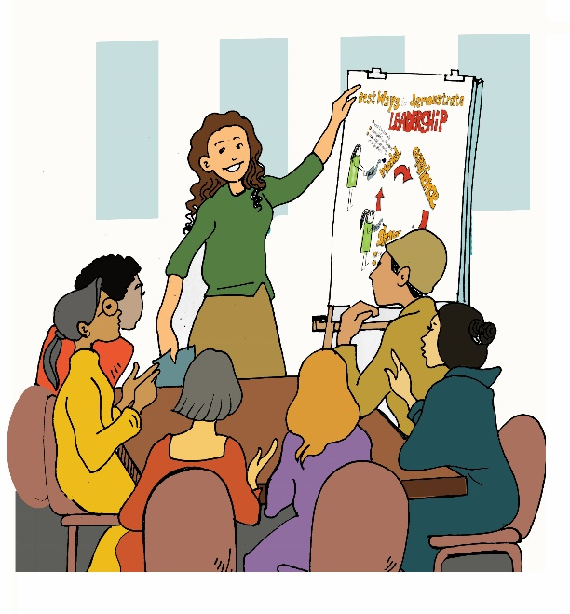
Getting Community Input
Exercises to be undertaken with Refugee groups, and other key stakeholders to gain their insights.
Notes:
To ensure that local knowledge and experience is used as a basis for completing the checklist, it is suggested that this tool be completed with various groups of stakeholders, and their answers combined.
These will then inform strategic planning

Slide 16
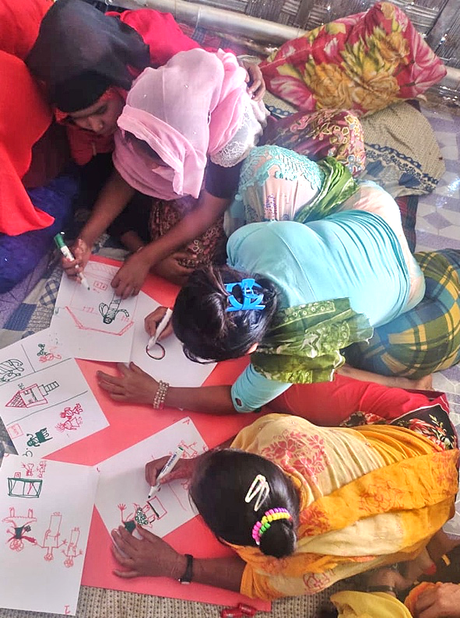
The Storyboard Tool
A less formal way of analysing the situation and one suitable for situations where some of the participants might be pre-literate, would be to use the Storyboarding Exercise
They draw and present their responses to questions about a problem facing their community, what is available to respond to this problem, their ideas for other solutions, and what role the community, NGOs or other groups could take in these solutions.
These are documented and form core research data.
Notes:
See StoryBoards Session 5, in Reciprocal Research, in the Additional Materials for full details of how to do this exercise

Slide 17
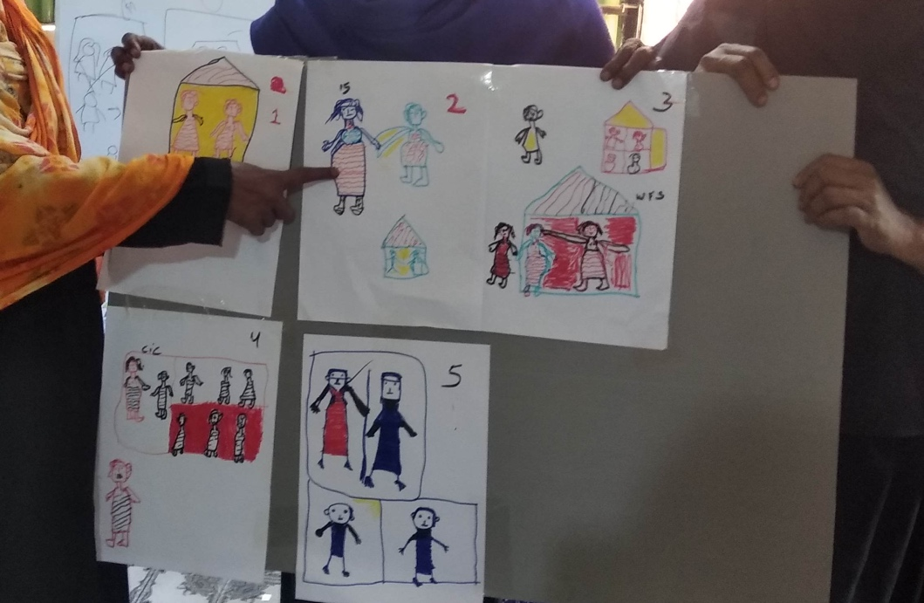
The Storyboard Tool
If Storyboarding is used, the six questions would be:
What are the biggest barriers to refugee led work which the women’s groups in xx site experience?
What are the impacts of these barriers on the women’s groups?
Which local stakeholders might be able to help to change this?
What do the women need to be able to move forward and run their own organisations?
What actions can realistically and safely be taken to support WRLOs?
What are the hoped for outcomes if this happens?
The facilitators of the groups would then combine the feedback and fill in the Checklist
Notes:
You will need to have the materials to run this exercise before the session.
They are:
Large sheets of coloured cardboard, 1 per group
White A4 paper, at least 6 sheets per group
Glue or sticky tape,
Thick Textas or crayons in bold colours. The pictures need to be clearly seen when the groups present their storyboards.

