Slide 1
Module 3:‘Intersectionality’ and ‘Age, Gender and Diversity’: How can we use them?

Slide 2
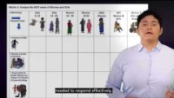
Part 4: The Matrix: An intersectionality and AGD analytical tool
[UNHCR and UNSW]

Slide 3
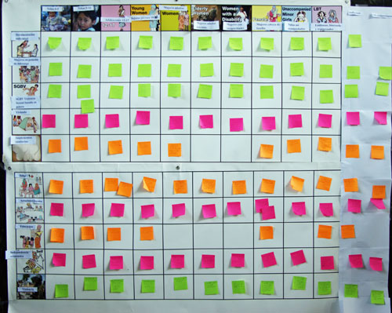
Using a Matrix as a tool for analysis
The matrix is a table of different ‘issues of concern’ or human rights (shown on the left side of the matrix), along with different categories of people in the community (shown along the top of the matrix).

Slide 4
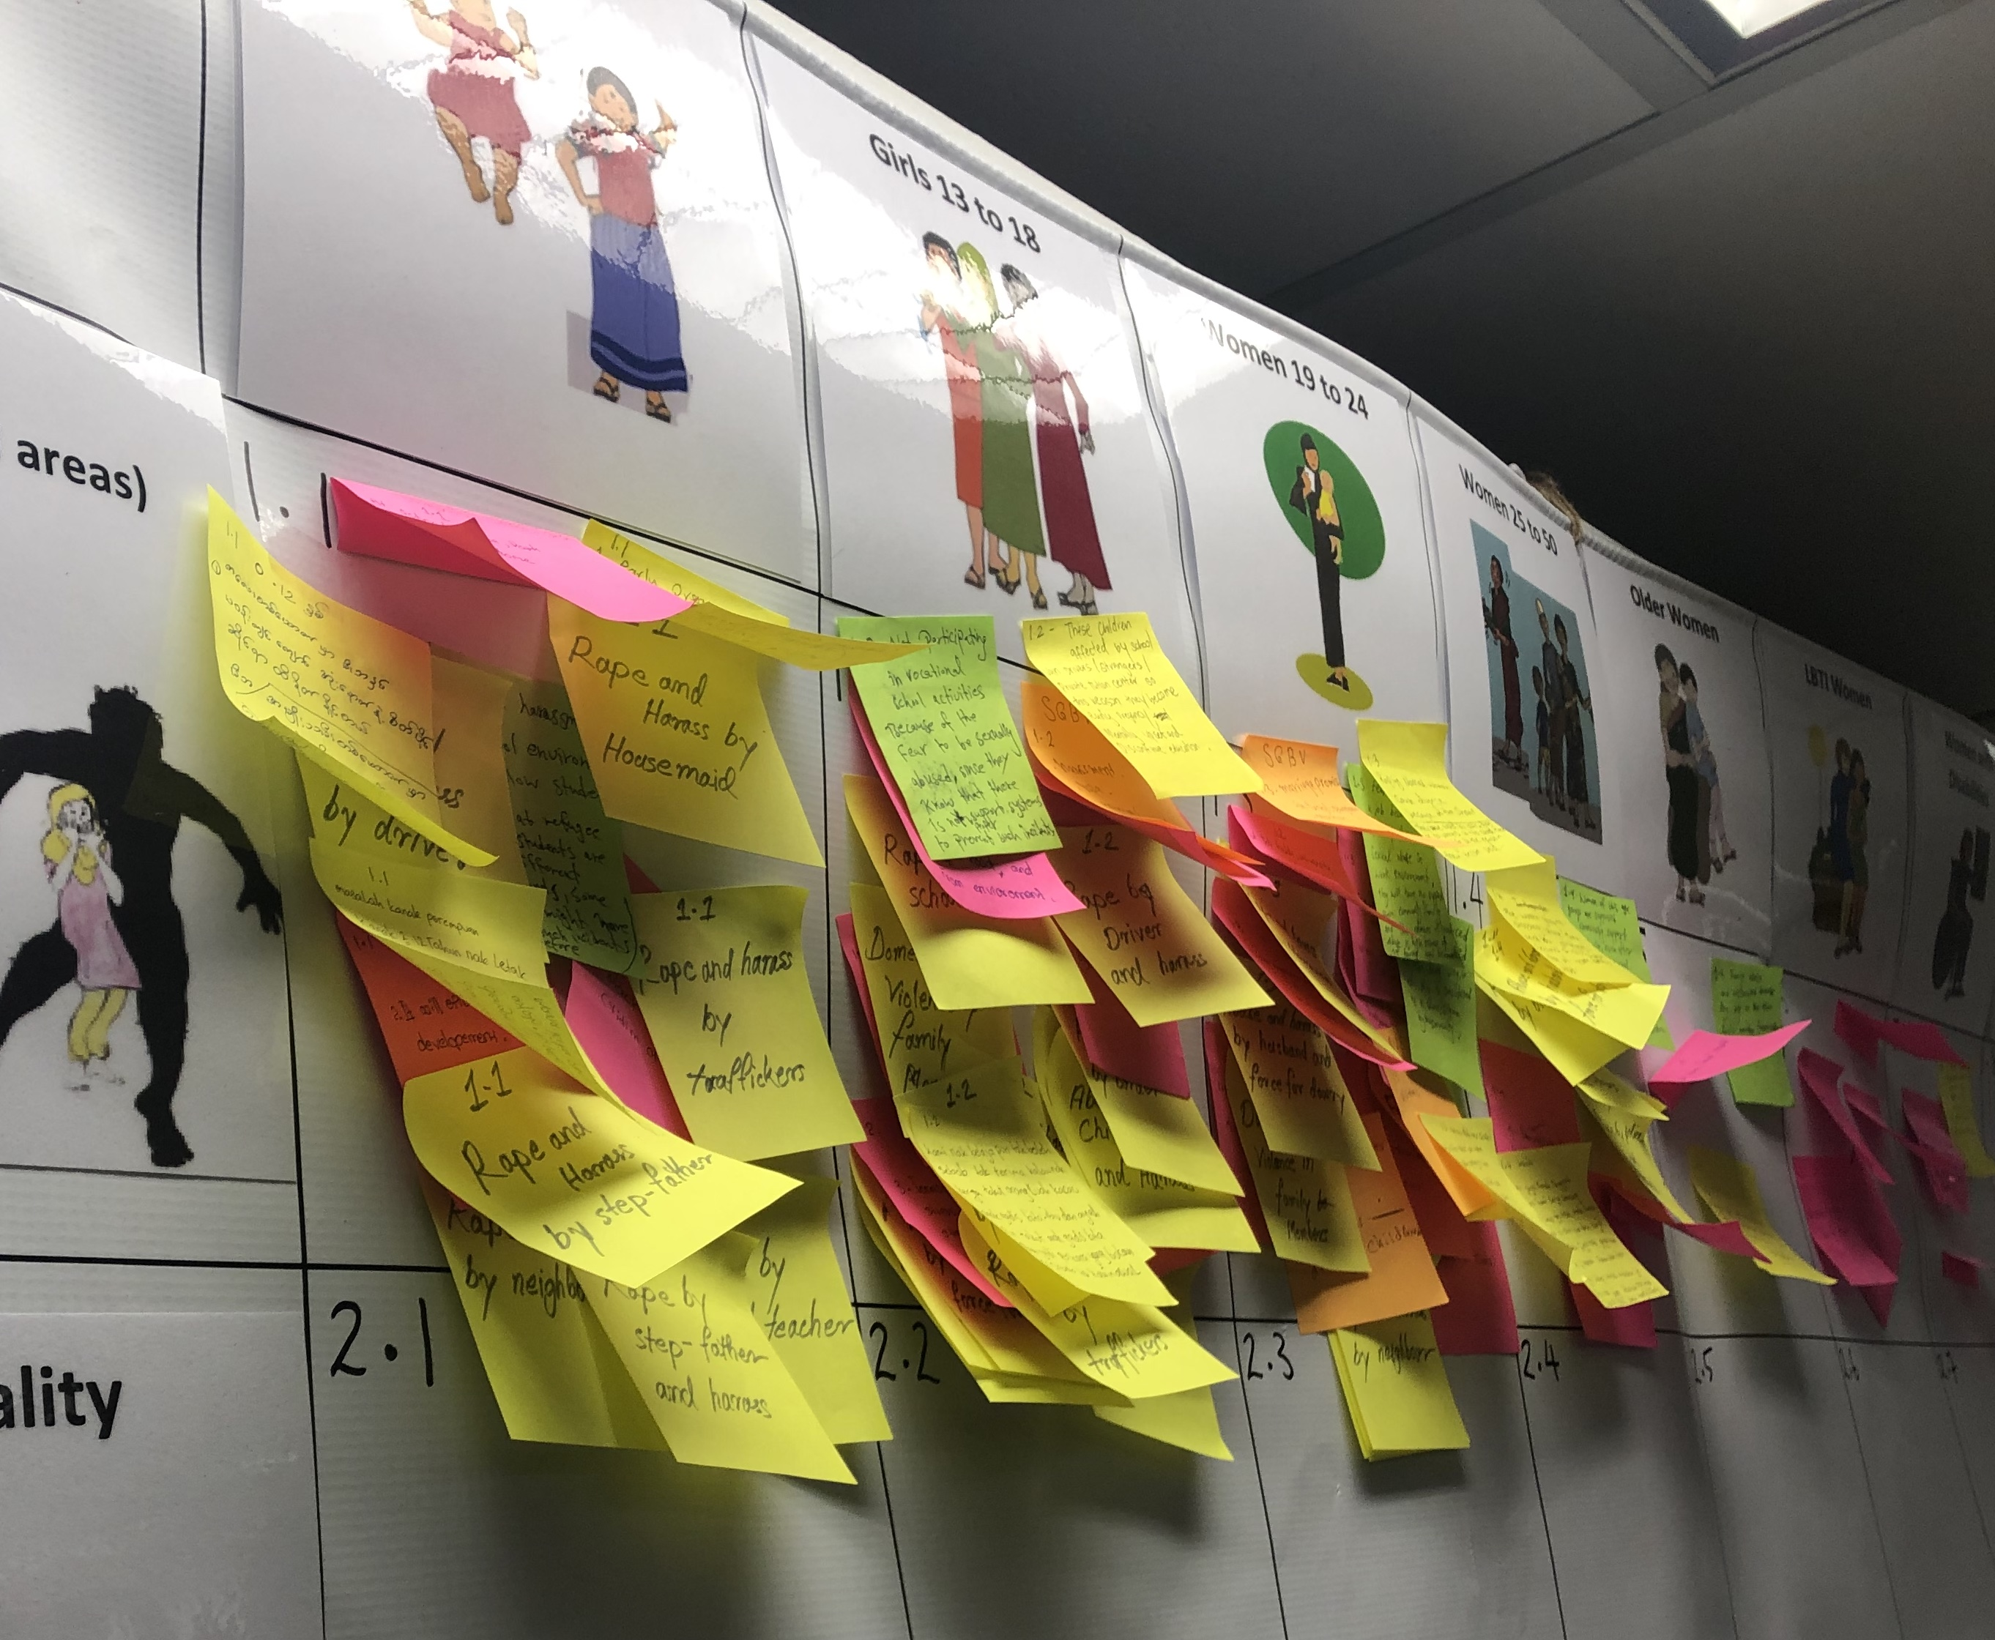
Building evidence on the Matrix
In small groups, participants discuss the different ways that each issue of concern impacts on each diverse category of people. They write their responses on ‘post it’ notes, one for each issue they want to put in box in the matrix.

Slide 5
Completing the Matrix
Each small group presents the points they have discussed to the rest of the participants, adding their sticky notes to the correct box on the matrix.

Slide 6
Matrix exercise – AGD and Intersectional analysis
In small groups you will be allocated a section of the matrix to work with. For the issue/s you are given, discuss how it impacts each of the diverse groups along the top of the matrix.
Write your points on sticky labels so that you can attach them to the matrix.

Slide 7

Filling in the Matrix

Slide 8
Suggesting solutions
In your small groups, discuss the challenges of tailoring services to meet the diverse needs represented in the matrix.
Choose one of the categories they discussed and suggest some strategies for addressing the issues identified.

Slide 9
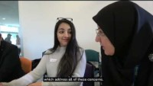
Part 5: How to use this knowledge in our work
[UNHCR and UNSW]

Slide 10
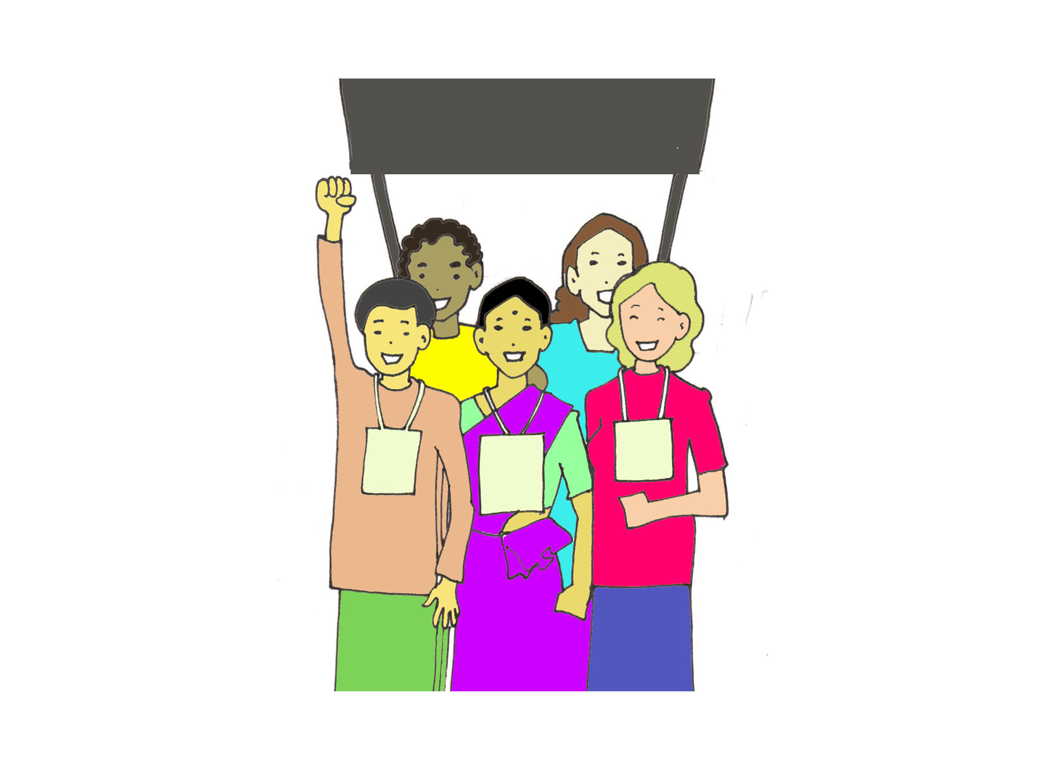
When should we use intersectionality and AGD?
All the time!
In all situations and in all of our work.
All programs must be based on a comprehensive AGD and intersectional analysis.
Draw on strengths and diversities to address discrimination.

Slide 11
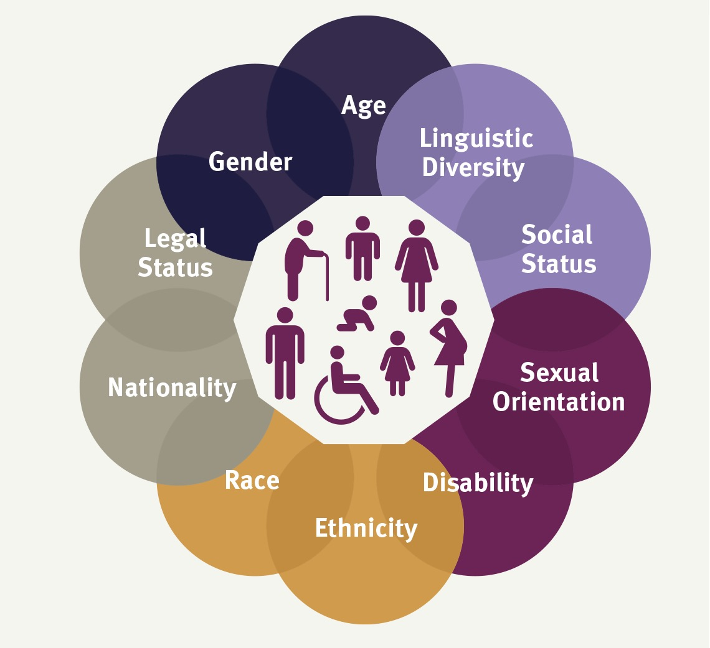
Wrapping up
The aim of this training was to get you familiar with the concepts of ‘intersectionality’ and ‘Age, Gender and Diversity’ (AGD), why they matter, and how we can all use them in all of our work.

Slide 12
Wrapping up
What is ‘intersectionality’?
Intersectionality is the way that our different identities intersect and affect the way we are seen and treated by others
Intersectionality creates unique strengths but also compounding vulnerability and discrimination
What is ‘Age, Gender and Diversity’ (AGD)?
The AGD Policy recognises that refugees are very diverse, and that they all need to be treated equally and equally included in decision-making about their own lives

Slide 13
Wrapping up
Why do they matter?
Without intersectional and AGD analysis we cannot meet people’s diverse needs or utilise their unique strengths and talents
How can we use them?
Intersectional and AGD analysis should be used in all situations and in all of our work
We can use a matrix to analyse the diverse needs, challenges and strengths of diverse groups, and use this as the basis for policies and services

Slide 14
The End.
Congratulations!
We hope this helps you in your work

