Slide 1
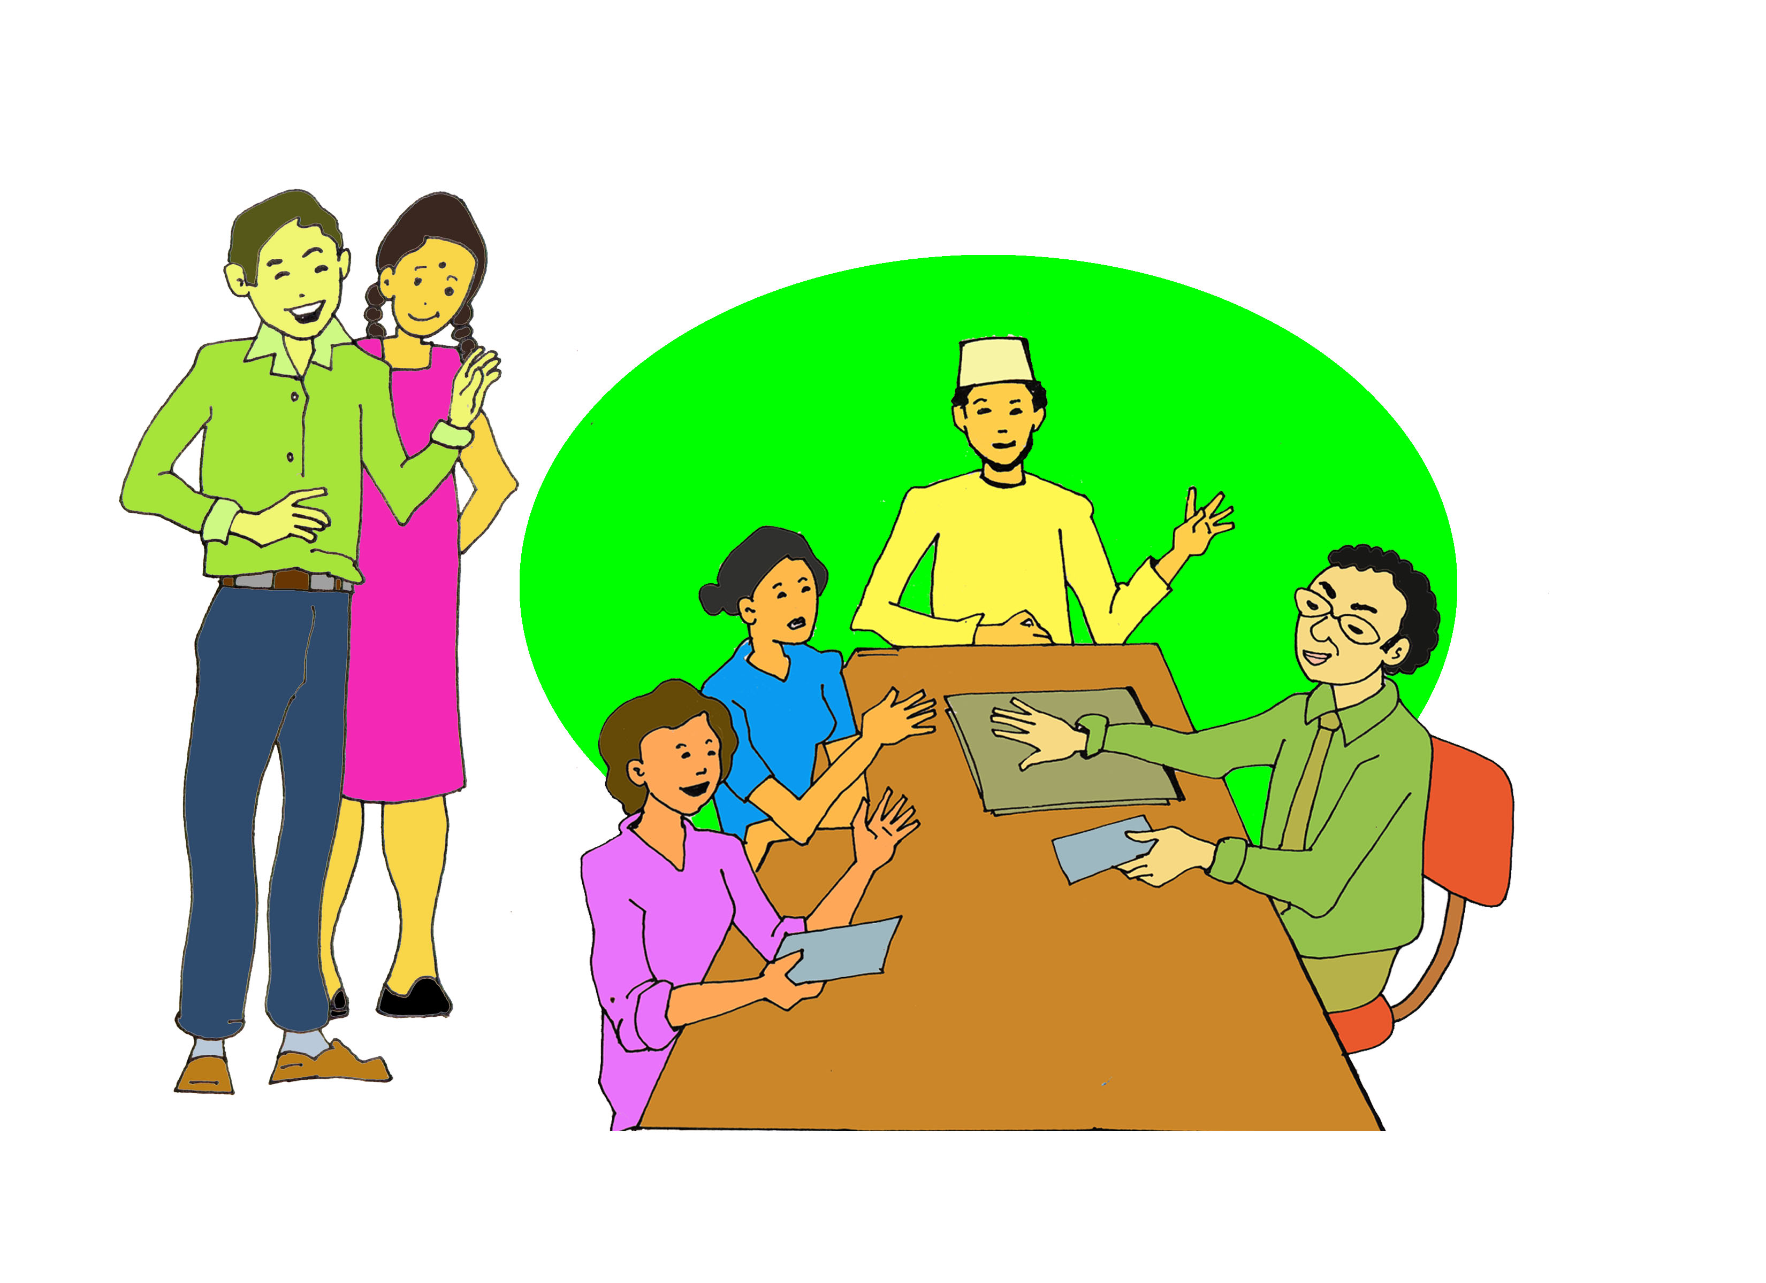
Session 6
Harnessing lived experience
Presented by Dr Linda Bartolomei and
Adjunct Professor Eileen Pittaway
Forced Migration Research Network UNSW
Notes:
Facilitators Notes
“Lived experience” is a current buzz phrase, used to mean that refugees must be included and listened to, because they have been, or still are refugees, and therefor know what they and their communities want and need.
For a number of structural and logistic reasons, such as the safety to speak out, access to decision makers, the ability to speak English, and confidence from prior education, the refugees who get to share their experience are mainly still those who have been resettled, or have some social advantages where they are living.
They have been doing a fantastic job, and the movement towards Participation and acknowledgement of the skills, wisdom and expertise of refugees is down to their incredibly hard work.
However, we still have a lot of work to do to ensure that refugees who have not had these advantages are also heard, and their lived experience is also taken in consideration.

Slide 2
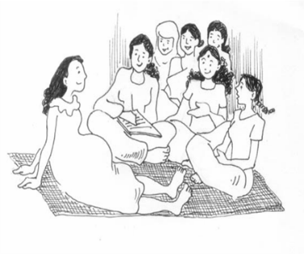
Why is this so important?
Valuing and acknowledging refugee lived experience is an approach that places refugees and their lived experiences at the centre of thinking. This refugee lived experience approach requires that policy, program development, service delivery and decision-making processes ensures refugees can actively participate and influence the outcome of their hopes, aspirations, and dreams. RCOA: https://www.refugeecouncil.org.au/wellbeing-lived-experience/
Notes:
We like this explanation from the Refugee Council of Australia, but you or the participants may have a better one.

Slide 3
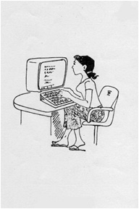
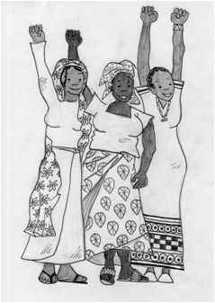
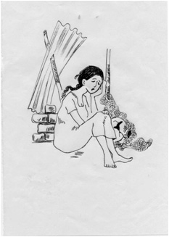
Every experience counts!
The people who are recognized as community leaders in refugee situations are not always the ones who would have led the community in the past, and may lack the appropriate knowledge to navigate the context of displacement and alien social structures. Some who take gatekeeper roles revert to old power bases, which often exclude or negatively impact women and girls (Pittaway, Muli and Shteir 2009).
Notes:
See background reading for further information.

Slide 4
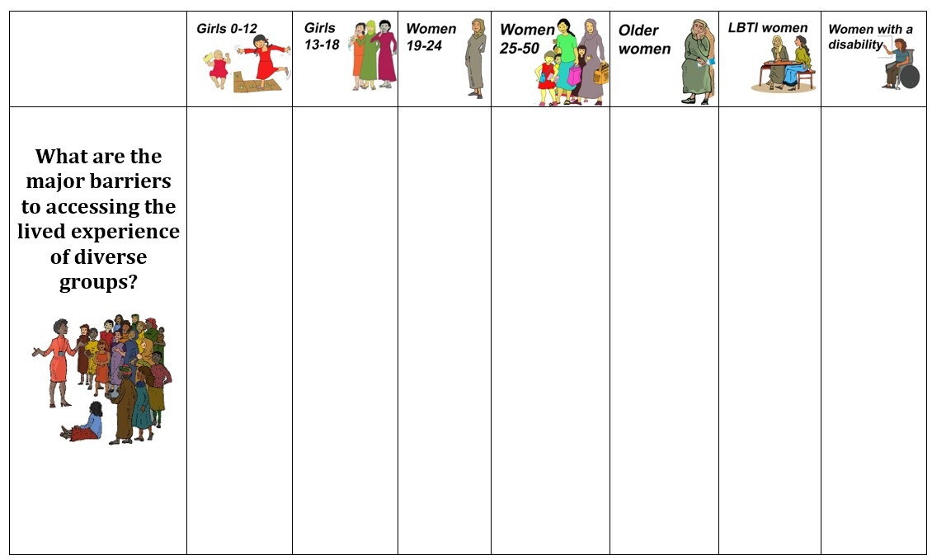
Identifying Barriers to acknowledging lived experience for diverse and isolated women
Notes:
The Matrix exercise is an excellent way to examine the barriers to people from diverse backgrounds sharing their experience. If you have not used it before, please go to Reciprocal Research in Additional Resources Session 7

Slide 5
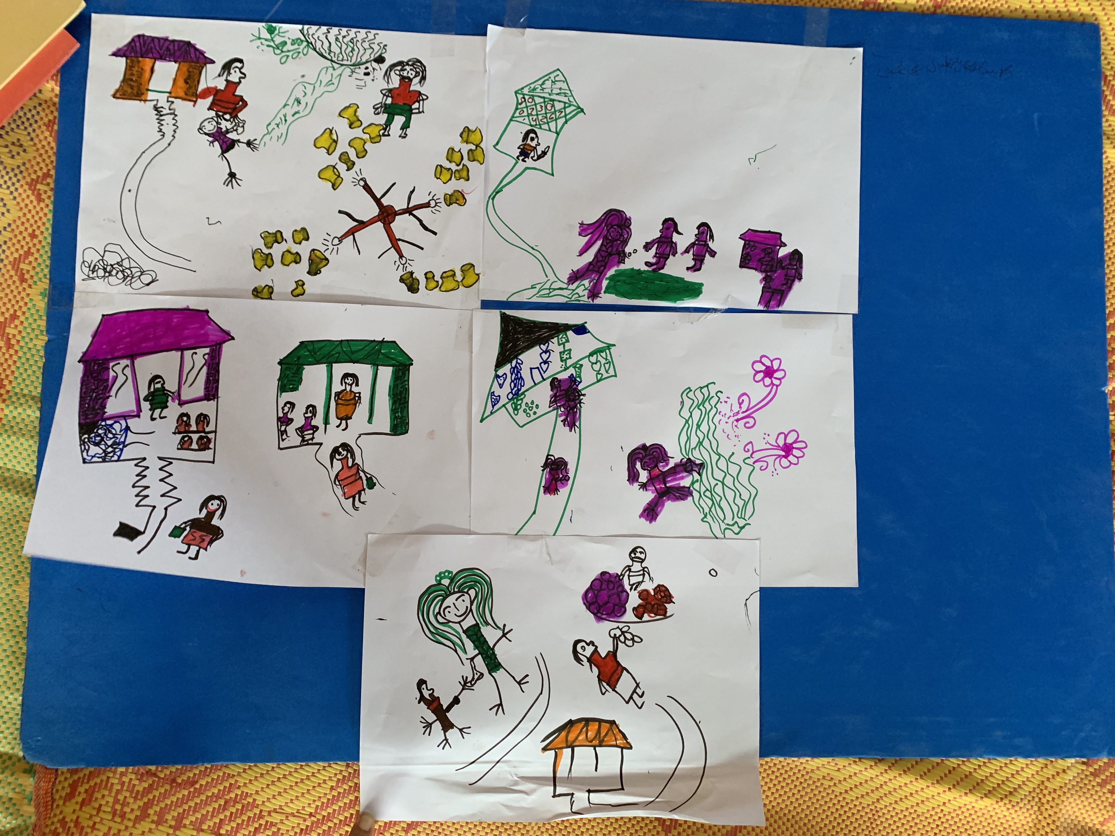
These are suggested story board questions
What are some of the barriers experienced by women and girls in having their voices heard in refugee situations?
How does this make them feel?
What is the impact of them not sharing their knowledge and experience?
What needs to be done to address these barriers? What support, and resources would the groups need to feel confident to speak out?
Who can help with this?
What would be the positive outcomes of this happening?
Notes:
Storyboards move from problems identification to solutions. See Reciprocal Research in Additional Resources Session 8

Slide 6
The exercises on Identity Layers and Identity Labels in the AGD Resource kit are also useful to enable stakeholders, including refugees, examine the impact these layers and labels have on the ability of refugee women and men to be included in decision making and have their voices heard.
Notes:
Please see the AGD Resource Kit and video link for the Labels exercise.
https://www.unhcr.org/au/what-we-do/how-we-work/safeguarding-individuals/intersectionality-and-age-gender-diversity-approach

Slide 7
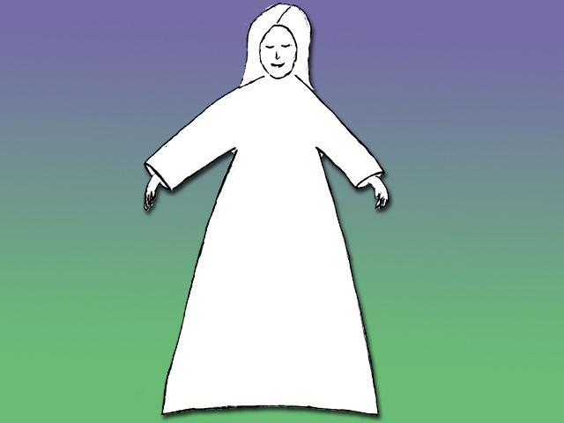
Refugee
Woman
Raped woman
Poor
Frightened
Victim
Vulnerable
Dependent Upon Charity
Non English Speaker
Notes:
This is an animated slide, you need to click to add each word. The final click brings up the Refugee Woman label.
The key point is that the negative labels rob the woman of her identity

Slide 8
Refugee
Woman
Muslim
Teacher
Community Leader
Protector
Wife & Daughter
Strong
Mother
Head of Family
Notes:
Now we see the “ideal’ refugee woman. The one we would all like to be or to work with.

Slide 9
Refugee
Woman
Teacher
Poor
Muslim
Frightened
Non English Speaker
Protector
Wife & Daughter
Victim
Strong
Mother
Vulnerable
Head of Family
Dependent Upon Charity
Notes:
And finally, the truth. It is the same woman, and she is all of these things, and much more.
Discuss with the group the importance of responding to both her strengths and also her needs, not just one or the other.

Slide 10
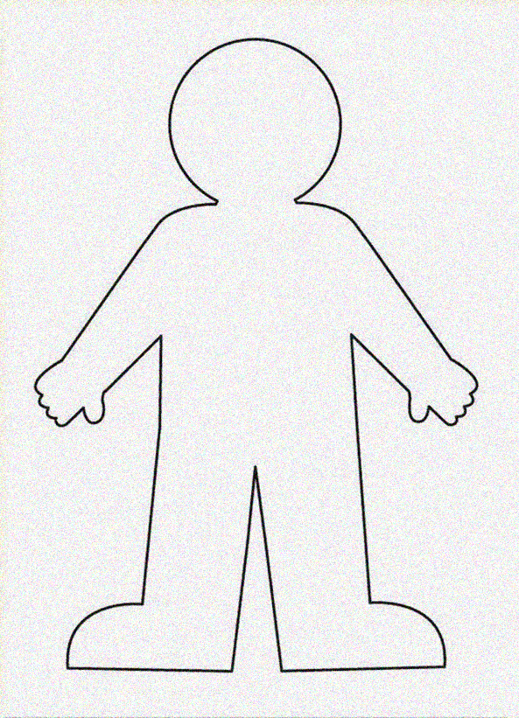
Do this exercise using these blank outlines
for men and for women
Notes:
You can download and print these graphics from in the Tools section of this Module

Slide 11
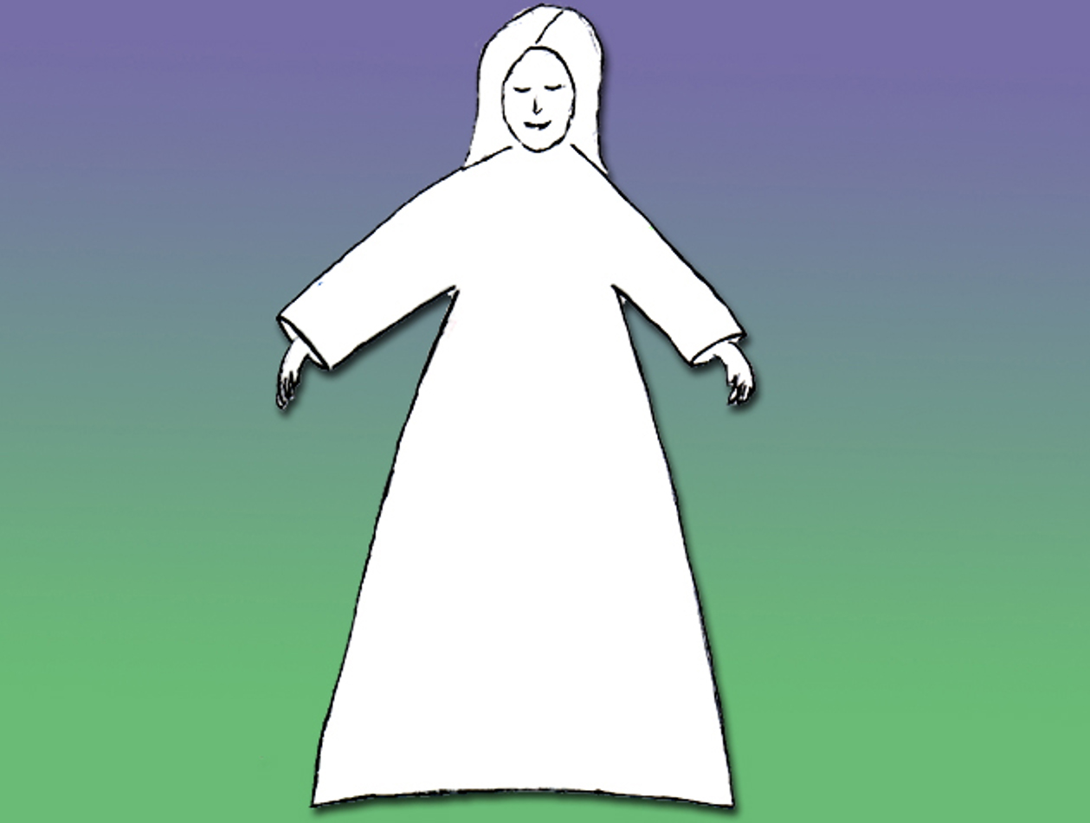
When they are completed add this to the other data you have gathered, to ensure that you both address all needs, but also respect all of the diverse experience identified.

Slide 12
Question
How can we be sure that we always include the lived experience of very diverse refugee groups?
Notes:
Once the group has completed sharing their work, wrap up the session by brainstorming this important question.

