Slide 1
Presenter Name here
School Name Parent Information Session
Date
Insert your school crest here

Slide 2
Insert local photo of your school grounds or well-known place in local Country

Slide 3
Schools are becoming increasingly aware of our obligations to Aboriginal and Torres Strait Islander communities, and to educating all Australian children about Aboriginal histories and cultures
This is part of education policy, e.g. the Professional Standards for Teachers, Cross Curriculum Priorities, and Aboriginal Education Policy
This is important for both Aboriginal and non-Aboriginal students
The Know Your Country campaign

Slide 4
Why is it important for your child at ________School to learn about First Nations perspectives, histories and cultures?

Slide 6
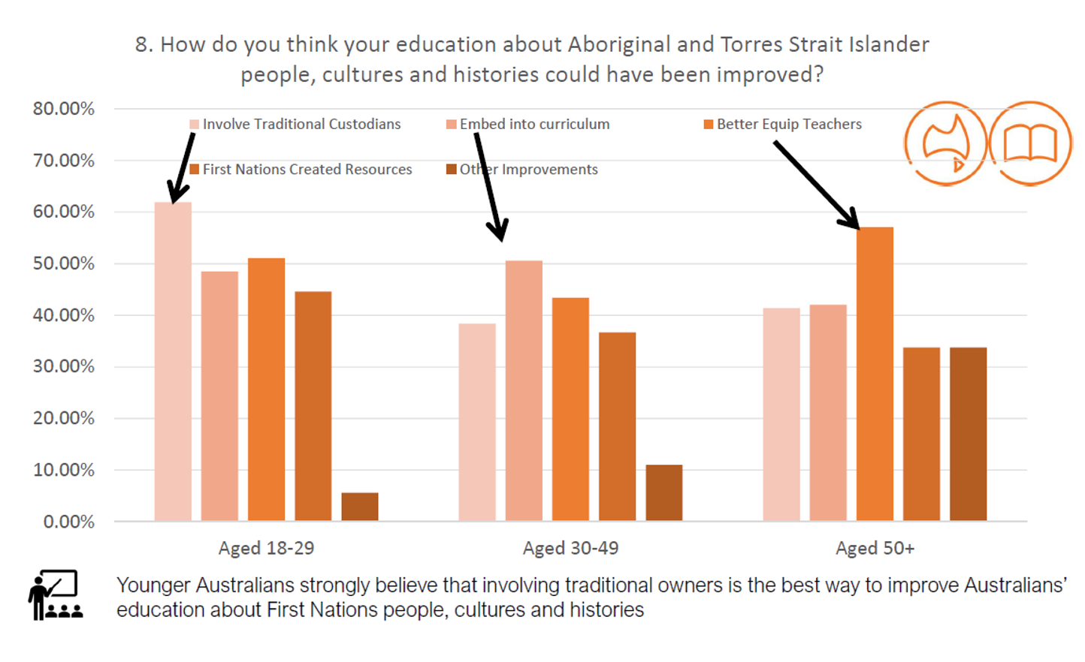

Slide 7
A local Aboriginal Cultural Educator (insert name if known) is employed by the school for _ days per week
S/he will work with classroom teachers to (collaboratively) plan, implement, document and evaluate the integration of Aboriginal histories, knowledges and cultures across the curriculum through specific units of work for all students.
Topics may include local and personal history, language, creative arts, local plants and animals (tailor to suit)

Slide 8
Each classroom will work with the Cultural Educator _ lesson(s) for _ days per week (tailor to suit)
Stage leaders will work with their staff to plan for how the Cultural Educator can contribute to particular units of work experienced by all students in a stage
Teachers will engage in professional learning across the year to improve their understanding of Aboriginal histories and cultures
The Cultural Educator is part of our school community, contributing to school-wide events such as Reconciliation Week and NAIDOC Week.
The Cultural Educator will help us build relationships with others in the local Aboriginal community.

Slide 9
Insert specific ideas for implementation at your school.
Insert picture from your school context

Slide 10
Contact:
Your Name
Your Title
Your email/phone

